Slide 1
Python Introduction

Slide 2
What is Python?
Python is a popular programming language. It was created by Guido van Rossum, and released in 1991.
It is used for:
Web development (server-side)
Software development
Mathematics
System scripting.
Notes:
A scripting language or script language is a programming language that is used to manipulate, customize, and automate the facilities of an existing system.[1] Scripting languages are usually interpreted at runtime rather than compiled.

Slide 3
What can Python do?
Python can be used on a server to create web applications.
Python can be used alongside software to create workflows.
Python can connect to database systems. It can also read and modify files.
Python can be used to handle big data and perform complex mathematics.
Python can be used for rapid prototyping, or for production-ready software development.
Notes:
A Workflow is defined as a sequence of tasks that processes data through a specific path from initiation to completion. They can be used to structure any kind of business function regardless of industry.

Slide 4
Why Python?
Python works on different platforms (Windows, Mac, Linux, Raspberry Pi, etc).
Python has a simple syntax similar to the English language.
Python has syntax that allows developers to write programs with fewer lines than some other programming languages.
Python runs on an interpreter system, meaning that code can be executed as soon as it is written. This means that prototyping can be very quick.
Python can be treated in a procedural way, an object-oriented way or a functional way.
Notes:
Raspberry Pi OS (formerly Raspbian) is a Unix-like operating system based on the Debian Linux distribution for the Raspberry Pi family of compact single-board computers. First developed independently in 2012, it has been produced as the primary operating system for these boards since 2013, distributed by the Raspberry Pi Foundation.[3]

Slide 5
Where to write Python code?
The most recent major version of Python is Python 3, which we shall be using in this course.
Python can be written in:
Text editor.
Jupyter Lab Notebook is the latest web-based interactive development environment
Integrated Development Environment (IDE), such as Thonny, Pycharm, Netbeans, Eclipse, Spyder, Anaconda which are particularly useful when managing larger collections of Python files.

Slide 6
Python Syntax compared to other programming languages
Python was designed for readability, and has some similarities to the English language with influence from mathematics.
Python uses new lines to complete a command, as opposed to other programming languages which often use semicolons or parentheses.
Python relies on indentation, using whitespace, to define scope; such as the scope of loops, functions and classes. Other programming languages often use curly-brackets for this purpose.

Slide 7
Python Install
Many PCs and Macs will have python already installed.
To check if you have python installed on a Windows PC, search in the start bar for Python or run the following on the Command Line (cmd.exe):
C:\Users\Your Name>python --version

Slide 8
Python QuickStart
Python is an interpreted programming language, this means that as a developer you write Python (.py) files in a text editor and then put those files into the python interpreter to be executed.
Suppose the name of your python file "helloworld.py", it has:
print("Hello, World!")
The way to run a python file is like this on the command line:
C:\Users\Your Name>python helloworld.py
The output should read:
Hello, World!

Slide 9
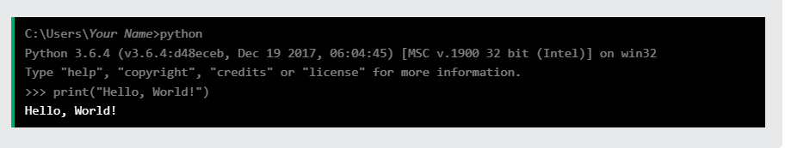
The Python Command Line
To test a short amount of code in python sometimes it is quickest and easiest not to write the code in a file. This is made possible because Python can be run as a command line itself.
Type the following on the Windows, Mac or Linux command line:
C:\Users\Your Name>python
Or, if the "python" command did not work, you can try "py":
C:\Users\Your Name>py
Whenever you are done in the python command line, you can simply type the following to quit the python command line interface:
exit()

Slide 10
Python Indentation
Indentation refers to the spaces at the beginning of a code line.
Where in other programming languages the indentation in code is for readability only, the indentation in Python is very important.
Python uses indentation to indicate a block of code.
Example
if 5 > 2: print("Five is greater than two!")
Python will give you an error if you skip the indentation:
Syntax Error:
if 5 > 2: print("Five is greater than two!")

Slide 11
The number of spaces is up to you as a programmer, the most common use is four, but it has to be at least one.
Example
if 5 > 2: print("Five is greater than two!") if 5 > 2: print("Five is greater than two!")
You have to use the same number of spaces in the same block of code, otherwise Python will give you an error:
Syntax Error:
if 5 > 2: print("Five is greater than two!") print("Five is greater than two!")

Slide 12
Python Comments
Comments can be used to
explain Python code.
make the code more readable.
to prevent execution when testing code.
Comments starts with a #, and Python will ignore them:
Example
#This is a comment print("Hello, World!")

Slide 13
Comments can be placed at the end of a line, and Python will ignore the rest of the line:
Example
print("Hello, World!") #This is a comment
A comment does not have to be text that explains the code, it can also be used to prevent Python from executing code:
Example
#print("Hello, World!") print("Cheers, Mate!")

Slide 14
Multi Line Comments
Python does not really have a syntax for multi line comments.
To add a multiline comment you could insert a # for each line:
Example
#This is a comment #written in #more than just one line print("Hello, World!")

Slide 15
Or, not quite as intended, you can use a multiline string.
Since Python will ignore string literals that are not assigned to a variable, you can add a multiline string (triple quotes) in your code, and place your comment inside it:
Example
""" This is a comment written in more than just one line """ print("Hello, World!")

Slide 16
Python Variables
Variables are containers for storing data values.
Python has no command for declaring a variable.
A variable is created the moment you first assign a value to it.
Example
x = 5 y = "John" print(x) print(y)

Slide 17
Variables do not need to be declared with any particular type, and can even change type after they have been set.
Example
x = 4 # x is of type int x = "Sally" # x is now of type str print(x)

Slide 18
Casting
If you want to specify the data type of a variable, this can be done with casting.
Example
x = str(3) # x will be '3' y = int(3) # y will be 3 z = float(3) # z will be 3.0
You can get the data type of a variable with the type() function.
Example
x = 5 y = "John" print(type(x)) print(type(y))

Slide 19
Single or Double Quotes?
String variables can be declared either by using single or double quotes:
Example
x = "John" # is the same as x = 'John'

Slide 20
Case-Sensitive
Variable names are case-sensitive.
Example
This will create two variables:
a = 4 A = "Sally" #A will not overwrite a

Slide 21
Python - Variable Names
A variable can have a short name (like x and y) or a more descriptive name (age, carname, total_volume).
Rules for Python variables:
A variable name must start with a letter or the underscore character
A variable name cannot start with a number
A variable name can only contain alpha-numeric characters and underscores (A-z, 0-9, and _ )
Variable names are case-sensitive (age, Age and AGE are three different variables)

Slide 22
Example : Legal variable names:
myvar = "John" my_var = "John" _my_var = "John" myVar = "John" MYVAR = "John" myvar2 = "John“
Example : Illegal variable names:
2myvar = "John" my-var = "John" my var = "John“
Remember that variable names are case-sensitive

Slide 23
Multi Words Variable Names
Variable names with more than one word can be difficult to read.
There are several techniques you can use to make them more readable:
Camel Case
Each word, except the first, starts with a capital letter:
myVariableName = "John"
Pascal Case
Each word starts with a capital letter:
MyVariableName = "John"
Snake Case
Each word is separated by an underscore character:
my_variable_name = "John"

Slide 24
Python Variables - Assign Multiple Values
Many Values to Multiple Variables
Python allows you to assign values to multiple variables in one line
Example
x, y, z = "Orange", "Banana", "Cherry" print(x) print(y) print(z)
Note: Make sure the number of variables matches the number of values, or else you will get an error.

Slide 25
One Value to Multiple Variables
And you can assign the same value to multiple variables in one line
Example
x = y = z = "Orange" print(x) print(y) print(z)

Slide 26
Unpack a Collection
If you have a collection of values in a list, tuple etc. Python allows you to extract the values into variables. This is called unpacking.
Example
fruits = ["apple", "banana", "cherry"] x, y, z = fruits print(x) print(y) print(z)

Slide 27
Output Variables
The Python print() function is often used to output variables.
x = "Python is awesome" print(x)
In the print() function, you output multiple variables, separated by a comma:
x = "Python" y = "is" z = "awesome" print(x, y, z)

Slide 28
You can also use the + operator to output multiple string variables:
x = "Python " y = "is " z = "awesome" print(x + y + z)
For numbers, the + character works as a mathematical operator:
x = 5 y = 10 print(x + y)

Slide 29
In the print() function, when you try to combine a string and a number with the + operator, Python will give you an error:
x = 5 y = "John" print(x + y)
The best way to output multiple variables in the print() function is to separate them with commas, which even support different data types:
x = 5 y = "John" print(x, y)

Slide 30
Python - Global Variables
Variables that are created outside of a function are known as global variables.
Global variables can be used by everyone, both inside of functions and outside.
x = "awesome" def myfunc(): print("Python is " + x) myfunc()

Slide 31
If you create a variable with the same name inside a function, this variable will be local, and can only be used inside the function. The global variable with the same name will remain as it was, global and with the original value.
Example
#Create a variable inside a function, with the same name as the global variable
x = "awesome" def myfunc(): x = "fantastic" print("Python is " + x) myfunc() print("Python is " + x)

Slide 32
The global Keyword
Normally, when you create a variable inside a function, that variable is local, and can only be used inside that function.
To create a global variable inside a function, you can use the global keyword. If you use the global keyword, the variable belongs to the global scope:
Example
def myfunc(): global x x = "fantastic" myfunc() print("Python is " + x)

Slide 33
Also, use the global keyword if you want to change a global variable inside a function.
To change the value of a global variable inside a function, refer to the variable by using the global keyword:
Example
x = "awesome" def myfunc(): global x x = "fantastic" myfunc() print("Python is " + x)

Slide 34
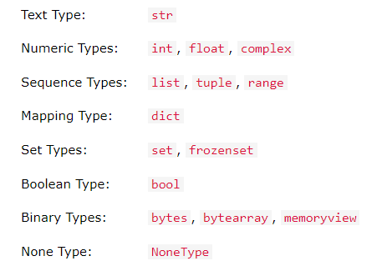
Python Data Types
Python has the following data types built-in by default, in these categories:

Slide 35
Getting the Data Type
In Python, the data type is set when you assign a value to a variable:
Example
Print the data type of the variable x:
x = 5 print(type(x))

Slide 36
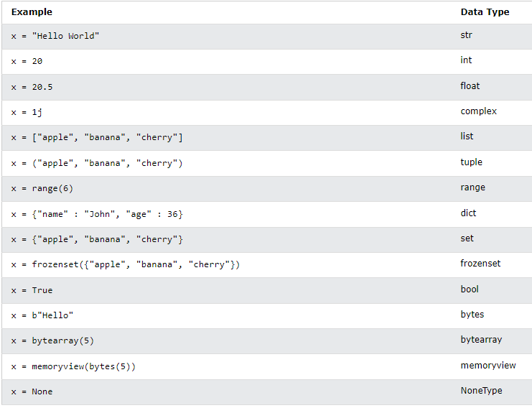

Slide 37
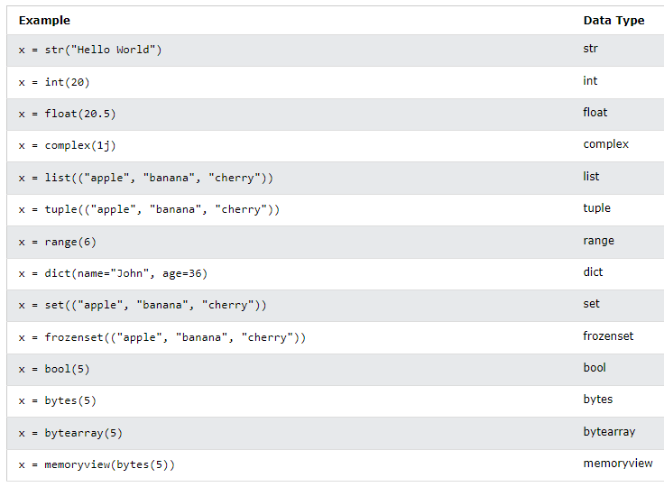
Setting the Specific Data Type

Slide 38
Python Numbers
There are three numeric types in Python:
int
float
complex
Variables of numeric types are created when you assign a value to them:
Example
x = 1 # int y = 2.8 # float z = 1j # complex
To verify the type of any object in Python, use the type() function:
Example
print(type(x))

Slide 39
int
int, or integer, is a whole number, positive or negative, without decimals, of unlimited length.
Example
x = 1 y = 35656222554887711 z = -3255522 print(type(x)) print(type(y)) print(type(z))

Slide 40
Float
Float, or "floating point number" is a number, positive or negative, containing one or more decimals.
Example
x = 1.10 y = 1.0 z = -35.59 print(type(x)) print(type(y)) print(type(z))

Slide 41
Float can also be scientific numbers with an "e" to indicate the power of 10.
Example
x = 35e3 y = 12E4 z = -87.7e100 print(type(x)) print(type(y)) print(type(z))

Slide 42
Complex
Complex numbers are written with a "j" as the imaginary part:
Example
x = 3+5j y = 5j z = -5j print(type(x)) print(type(y)) print(type(z))

Slide 43
Type Conversion
You can convert from one type to another with the int(), float(), and complex() methods:
Example
x = 1 # int y = 2.8 # float z = 1j # complex #convert from int to float: a = float(x) #convert from float to int: b = int(y) #convert from int to complex: c = complex(x) print(a, type(a)) print(b, type(b)) print(c, type(c))

Slide 44
Random Number
Python does not have a random() function to make a random number, but Python has a built-in module called random that can be used to make random numbers:
Example : Import the random module, and display a random number between 1 and 9:
import random print(random.randrange(1, 10))

Slide 45
Python Casting
Casting in python is therefore done using constructor functions:
int() - constructs an integer number from an integer literal, a float literal (by removing all decimals), or a string literal (providing the string represents a whole number)
float() - constructs a float number from an integer literal, a float literal or a string literal (providing the string represents a float or an integer)
str() - constructs a string from a wide variety of data types, including strings, integer literals and float literals

Slide 46
Example
Integers:
x = int(1) # x will be 1 y = int(2.8) # y will be 2 z = int("3") # z will be 3
Floats:
x = float(1) # x will be 1.0 y = float(2.8) # y will be 2.8 z = float("3") # z will be 3.0 w = float("4.2") # w will be 4.2
Strings:
x = str("s1") # x will be 's1' y = str(2) # y will be '2' z = str(3.0) # z will be '3.0'

Slide 47
Python User Input
Python allows for user input.
That means we are able to ask the user for input.
The method is a bit different in Python 3.6 than Python 2.7.
Python 3.6 uses the input() method.
Python 2.7 uses the raw_input() method.

Slide 48
The following example asks for the username, and when you entered the username, it gets printed on the screen:
Python 3.6
username = input("Enter username:") print("Username is: " + username)
Python 2.7
username = raw_input("Enter username:") print("Username is: " + username)

Slide 49
Python Booleans
You can evaluate any expression in Python, and get one of two answers, True or False.
Example
print(10 > 9) print(10 == 9) print(10 < 9)

Slide 50
When you run a condition in an if statement, Python returns True or False:
Example : Print a message based on whether the condition is True or False:
a = 200 b = 33 if b > a: print("b is greater than a") else: print("b is not greater than a")

Slide 51
bool() function
The bool() function allows you to evaluate any value, and give you True or False in return
Almost any value is evaluated to True if it has some sort of content.
Any string is True, except empty strings.
Any number is True, except 0.
Any list, tuple, set, and dictionary are True, except empty ones.
Example: Evaluate a string and a number:
print(bool("Hello")) print(bool(15))

Slide 52
Example: The following will return True:
bool("abc") bool(123) bool(["apple", "cherry", "banana"])
Example: The following will return False:
bool(False) bool(None) bool(0) bool("") bool(()) bool([]) bool({})

Slide 53
You can create functions that returns a Boolean Value:
Example: Print the answer of a function:
def myFunction() : return True print(myFunction())

Slide 54
Example: Print "YES!" if the function returns True, otherwise print "NO!":
def myFunction() : return True if myFunction(): print("YES!") else: print("NO!")
Python also has many built-in functions that return a boolean value, like the isinstance() function, which can be used to determine if an object is of a certain data type:
Example: Check if an object is an integer or not:
x = 200 print(isinstance(x, int))

Slide 55
Python Operators
Python divides the operators in the following groups:
Arithmetic operators
Assignment operators
Comparison operators
Logical operators
Identity operators
Membership operators
Bitwise operators

Slide 56
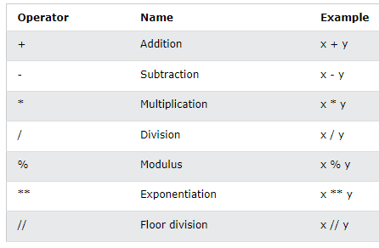
Python Arithmetic Operators

Slide 57
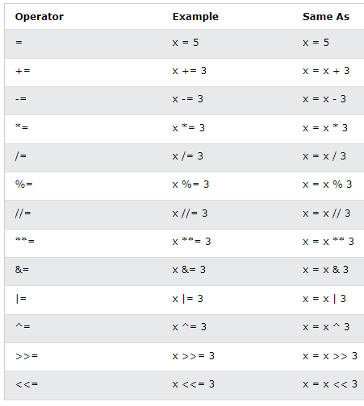
Python Assignment Operators

Slide 58
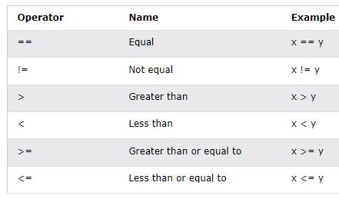
Python Comparison Operators

Slide 59
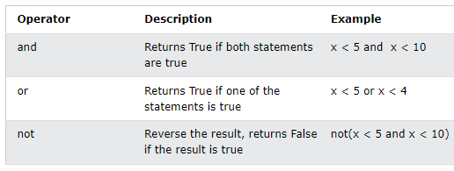
Python Logical Operators
Logical operators are used to combine conditional statements:

Slide 60
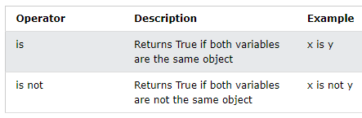
Python Identity Operators
Identity operators are used to compare the objects, not if they are equal, but if they are actually the same object, with the same memory location:

Slide 61
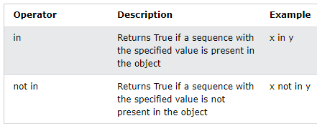
Python Membership Operators
Membership operators are used to test if a sequence is presented in an object:

Slide 62
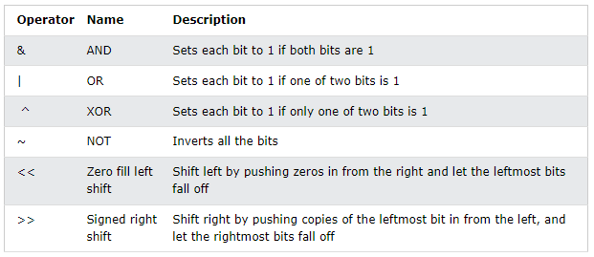
Python Bitwise Operators
Bitwise operators are used to compare (binary) numbers:

Slide 63
References
Python Tutorial (w3schools.com)

