Slide 1
Classes and Objects
In this topic you will learn:
Express classes and objects in Python
Implement methods and add data members to classes
Define access specifiers of data members

Slide 2
Overview
Object-oriented programming (OOP) involves programming using objects.
An object represents an entity in the real world that can be distinctly identified.
For example, a student, a desk, a circle, a button, and point can all be viewed as objects.
An object has a:
a unique identity,
state,
and behaviors.
The state of an object consists of a set of data fields (also known as properties) with their current values.
The behavior of an object is defined by a set of methods.
General class
class name ➔
identity
Point
+x : int (float) public
-y : int (float) Private(hid)
properties
state
operations
+ show(out): void
behavior
Class UML diagram
Notes:
2

Slide 3
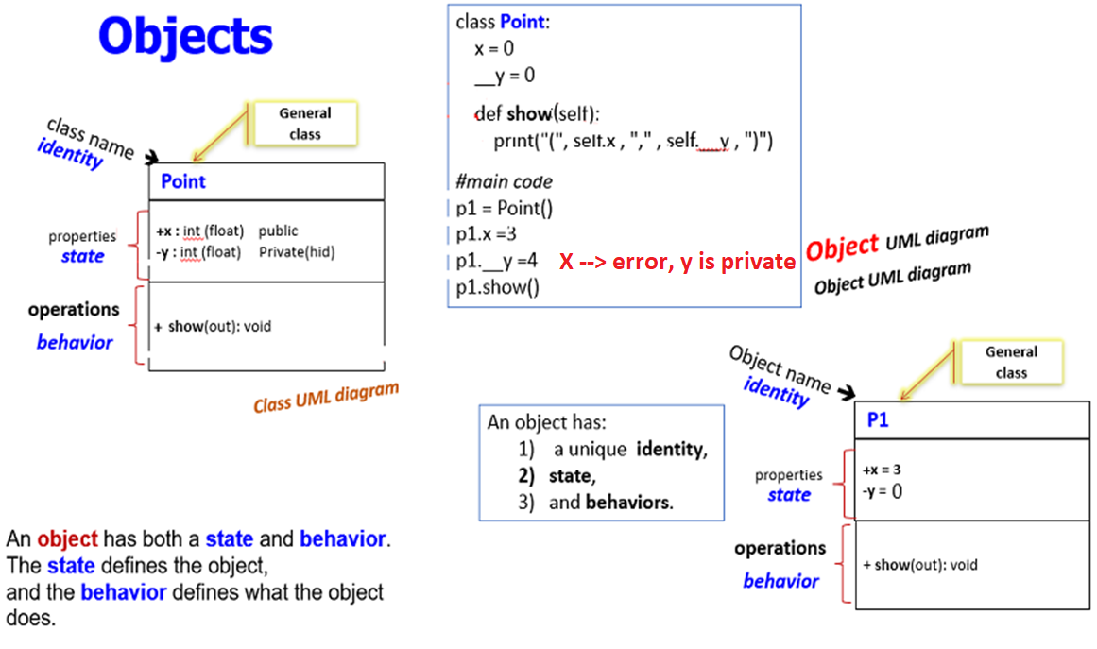

Slide 4
Defining a Class
Python was built as a procedural language
OOP exists and works fine, but Java probably does classes better than Python
Declaring a class in Python:
class Point:
x = 0
y = 0
#main code
class name:
statements
Notes:
4
4
4

Slide 5
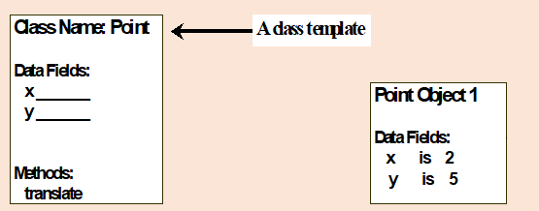
UML vs. Python
class Point:
x = 0
y = 0
def translate(self, a , b):
self.x = self.x + a
self.y += b
#------ ------
# main code
p1 = Point()
print("p1 ==> x= "+ str(p1.x))
print("p1 ==> y= "+ str(p1.y))
p1.translate(2 , 5)
print("p1 ==> x= "+ str(p1.x))
print("p1 ==> y= "+ str(p1.y))

Slide 6
declare or add fields:
which are the
attributes , properties or data members

Slide 7
Fields
point_class.py
1 2 3 | class Point: x = 0 y = 0
Fields can be declared directly inside class (as shown here)
Example:
class Point:
x = 0
y = 0
# main program
p1 = Point()
p1.x = 2
p1.y = -5
Or fields can be declared in constructors (more common)
Notes:
7
7
7

Slide 8
Using a Class
import point_class
or from point_class import *
client programs must import the classes they use
point_class.py
point_class.py
1 2 3 | class Point: x = 0 y = 0
point_main.py
1 2 3 4 5 6 7 8 9 10 11 12 | from point_class import * # import point_class # main p1 = Point() p1.x = 7 p1.y = -3 ... print(p1.x) p2 = Point() print(p2.y) # ➔ 0 print(p1.y) # ➔ -3
Notes:
8

Slide 9
Dynamic new Attribute for Object in Python
you can add fields anytime to the object

Slide 10
Using a Class
Class diagram
Point
import class
client programs must import the classes they use
point_class.py
1 2 3 | class Point: x = 0 y = 0
+x : int
+y : int
point_main.py
1 2 3 4 5 6 7 8 9 10 11 12 13 | from point_class import * # or import point_class # main p1 = Point() p1.x = 7 p1.y = -3 print(p1.x) #================= p2 = Point() print(p2.y) # ➔ 0 print(p1.y) # ➔ -3 # Python objects are dynamic (can add fields any time!) p2.name = "point 2"
Object diagram
p1
x = 7
y = -3
Object diagram
p2
x = 0
y = -3
name = "point 2"
Notes:
10

Slide 11
add Methods
to the object

Slide 12
Object Methods
Use the following to define a method for a class
def method_Name(self, parameter, ..., parameter):
statements
self must be the first parameter to any object method
Self is used to access the object's fields through
class Point:
x = 0
y = 0
def translate(self, dx, dy):
self.x += dx
self.y += dy
# --- main code
p1 = Point()
p1.translate(4 , 3)
print(p1.x)
print(p1.y)
Notes:
12
12
12

Slide 13
Parameter (self)
Python: self, explicit
def translate(self, dx, dy):
self.x += dx
self.y += dy
Exercise for the point class:
Write set_location, and distance_from_origin methods
then, distance_btwn2points method.
Notes:
13
13
13

Slide 14
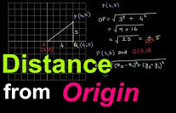
Exercise Answer
Exercise: Write set_location, and distance_from_origin methods.
from math import *
class Point:
x = 0
y = 0
def translate(self, dx, dy):
self.x += dx
self.y += dy
def set_location(self, x, y):
self.x = x
self.y = y
def distance_from_origin(self):
return sqrt(self.x * self.x + self.y * self.y)
# main code
p1 = Point()
p1.set_location(4, 3)
print( p1.distance_from_origin() )
Notes:
14

Slide 15
Again, Object Methods
self , other parameters
def name(self, other):
statements
self must be the first parameter to any object method
must access the object's fields through the self reference
When you understand what self is used to, then you are in middle of the journey

Slide 16
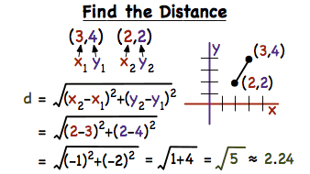
Exercise: add , distance_btwn2points methods.
from math import *
class Point:
x = 0
y = 0
def translate(self, dx, dy):
self.x += dx
self.y += dy
def set_location(self, x, y):
self.x = x
self.y = y
def distance_from_origin(self):
return sqrt(self.x * self.x + self.y * self.y)
def distance_btwn2points(self, other):
dx = self.x - other.x
dy = self.y - other.y
return sqrt(dx * dx + dy * dy)
# main code
…
…
….
# main code
p1 = Point()
p1.set_location(4, 3)
print(p1.distance_from_origin())
p2 = Point()
p2.set_location(4, 5)
print(p1.distance_btwn2points(p2))
Notes:
16

Slide 17
Constructors or initializer
for Class

Slide 18
Classes: Constructors
A Python class uses variables to store data fields and defines methods to perform actions.
Additionally, a class provides special type methods called Constructors, known as initializer, which is invoked to create a new object.
An initializer can perform any action, but initializer is designed to perform initializing actions, such as creating the data fields of objects.
class ClassName:
initializer
methods
Notes:
18

Slide 19
Classes: Constructors
def __init__(self, parameter1, ..., parameterN):
statements
A constructor is a special method with the name
__init__
Example:
class Point:
def __init__(self, x, y):
self.x = x
self.y = y
...
- How would we make it possible to construct a
Point() with no parameters to get (0, 0)?
Notes:
19
19
19

Slide 20
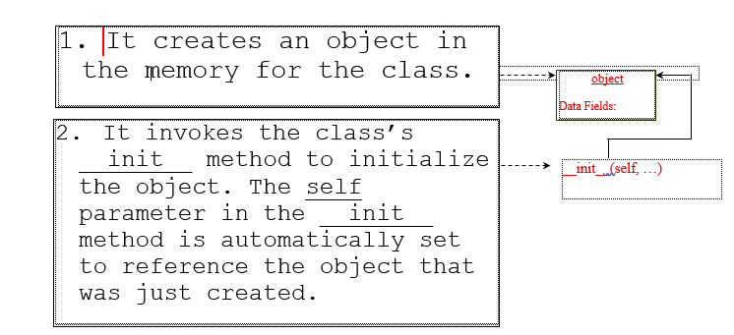
Constructing Objects
Once a class is defined, you can create objects from the class by using the following syntax, called a constructor:
initializer
def __init__(self,parameters….):
Notes:
20

Slide 21
Constructors
Full Example:
class Point:
x = 0
y = 0
def translate(self, dx, dy):
self.x += dx
self.y += dy
# main code
p1 = Point( )
p1.x = 3
p2.x = -4
print(p1.x)
class Point:
def __init__(self, x, y):
self.x = x
self.y = y
def translate(self, dx, dy):
self.x += dx
self.y += dy
# main code
p1 = Point(3, -4)
print(p1.x)
Can be shortened
and replaced to be
Notes:
21
21
21

Slide 22
Constructing Objects
The effect of constructing a point object using Point(5,7) is shown below:
22
Notes:
22

Slide 23
Two different ways to call Methods
in object

Slide 24
Calling Methods
A client can call the methods of an object in two ways:
(the value of self can be an implicit or explicit parameter)
1) object.method(parameters)
or
2) Class.method(object, parameters)
Example:
p1 = Point(3, -4) #← create object
p1.translate(1, 5)
Point.translate(p1, 1, 5)
class Point:
def __init__(self, x, y):
self.x = x
self.y = y
def translate(self, dx, dy):
self.x += dx
self.y += dy
# main code
p1 = Point(3, -4)
print(p1.x)
p1.translate(1, 5)
# or
Point.translate(p1, 1, 5)
Notes:
24

Slide 25
Class diagram
class Student:
def __init__(self, id , n, c , m):
self.id = id
self.name = n
self.courses =c
self.marks =m
def printAll(self):
print("id= ", self.id, "name= ",self.name, "\n courses= "\
,self.courses , "\n marks= ",self.marks )
def avg(self):
sum = 0.0
c = 0
for m in self.marks:
c+=1
sum += m
print("sum = ", sum, " c= " , c)
print("avg= " , sum/c)
#main program
s1= Student(1111, 'Ali' , ['cs1' , 'cs2' , 'cs3'], [90, 90, 20])
s1.printAll()
s1.courses.append('cs4')
s1.marks.append( 80)
print('-----after append -----')
s1.printAll()
print('\n-----print SUM & avg -----')
s1.avg()

Slide 26
toString
or __str__ in object

Slide 27
toString or __str__ in object
class Point:
def __init__(self, x, y):
self.x = x
self.y = y
# main code
p1 = Point(3, -4)
print(p1.x)
print( p1.x + " , " + p1.y )
print( "x= " + p1.x + " , " + "y= " + p1.y )
returns strings
like "( 3, -4 )"
or "( x=3, y=-4 )"
What is the problem
print( str(p1.x) + " , " + str(p1.y) )
print( "x= " + str(p1.x) + " , " + "y= " + str(p1.y) )

Slide 28
def __str__(self):
return string
equivalent to Java's toString (converts object to a string)
invoked automatically when str or print is called
Exercise: Write a __str__ method for Point objects that returns strings like "(3, -14)"
toString and __str__
def __str__(self):
return "(" + str(self.x) + ", " + str(self.y) + ")"
def display(self):
print(str(self))
Notes:
28

Slide 29
Complete Point Class
point.py
 | from math import * class Point: def __init__(self, x, y): self.x = x self.y = y def distance_from_origin(self): return sqrt(self.x * self.x + self.y * self.y) def distance_btwn2points(self, other): dx = self.x - other.x dy = self.y - other.y return sqrt(dx * dx + dy * dy) def translate(self, dx, dy): self.x += dx self.y += dy def __str__(self): return "(" + str(self.x) + ", " + str(self.y) + ")" def display(self): print(str(self))
Write a __str__ method for Point objects that returns strings like "(3, -14)"
# main code
p1 = Point(3, -14)
print(p1.x)
p1.display( )
# or
Point.display(p1)
Notes:
29

Slide 30
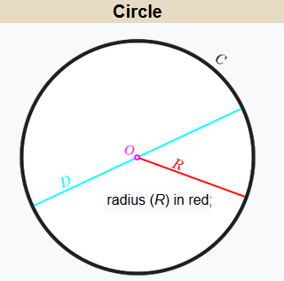
Complete Circle Class
Write a Circle Class :
1- Pi = 22.0/7.0 is a public data member.
2- Declare a constructor to set the radius of the Circle.
3- Add a method called ( Area ) to calc. the area of the circle.
4- Write a __str__ method for Circle objects that returns strings like "[Radius = 3.5, The circle Area = 38.0]"
5- Write a display method to print the final str returned output.
6- In the main code create c1 as new object with radius=3.5 . Print c1 data.
7- In the main code create c2 as new object with radius=7.0 . Print c2 data.
8- Draw the UML Class Diagram for Circle Class.
9- Draw the Object Diagram for c1, c2 object.
10- change the radius attr. for c2 to be = 8.5 and print the new data.
11- Name the program as circle.py
Radius

Slide 31
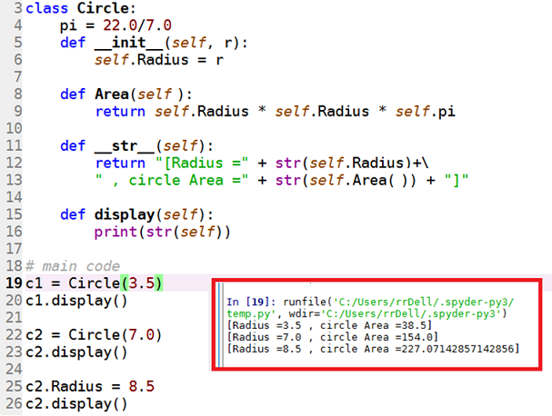
UML Circle Class
Circle
+ pi : float
+ Raduis : float
+ __init__( in r ): void
+ Area(in r:float ): float
+ __str__( … ): void
+ display( … ): void
Complete Circle Class

Slide 32
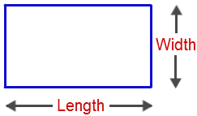
Write a Python oop code to define a Rectangle Class as follows :
1- Declare a constructor __init__ to initialize the length (L) & width (w) of the Rectangle.
2- Add a method called ( Area ) to calc. and return the area of the Rectangle .
3- Write a __str__ method for Rectangle objects that returns strings like "[length= 3 & width= 4 , The Rectangle Area = 12]“
5- Write a show method to print the final str toString returned output.
6- In main code create r1 as first object with L=3 & w=4 . Print object information using show( ) method.
7- In main code create r2 as new object with L=9 & w=6 . Print object information using show( ) method.
8- Draw the UML Class Diagram for Rectangle Class.
9- Draw the Object UML Diagram for r1, r2 objects.
10- In main code, change the length attr. for r2 to be = 6.5 and print object information .
11-Name your program ( Rectanlge.py )
Homework:a
Rectangle

Slide 33
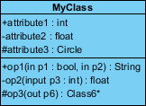
Encapsulation
Public
Private
Protected
Access Specifiers in Python

Slide 34
➔by
class A:
def __init__(self):
self.__priv = "I am private"
self._prot = "I am protected"
self.pub = "I am public"
Encapsulation

Slide 35
Accessing private variables using getter/setter
class A:
def __init__(self):
self.__priv = "I am private"
self._prot = "I am protected"
self.pub = "I am public"
class Point:
def __init__(self, x, y):
self.__x = x
self.__y = y
def setX(self, x):
self.__x = x
def getX(self):
return self.__x
def setY(self, y):
self.__y = y
def getY(self):
return self.__y
Point
- x : int (private)
- y : int (private)
+ setX(in x:int ): void
+ getX(out x ): int
+ setY(in y:int ): void
+ getY(out y ): int
p1 = Point(3, 5)
print(p1.__x)
# main code
p1 = Point(3, 5)
print(p1.GetX( ))
private

Slide 36
Write OOP Python code for the following UML class diagram:
Student
- id : int
- name : string
- course: [ ] string
+ phone : int
…
+ __init__( in id, name , phone ): void
+ setid(id:int ): int
+ getid( ): int
…
+ registerCrs( in crs:string ): string
+ display ( … ): void

Slide 37
class Student:
def __init__(self, i, n , t):
self.__id = i # private
self.__name = n # private
self.phone = t # public
self.__courses = [ ] # private and list
def setid(self, i):
self.__id = i
def getid(self):
return self.__id
def setname(self, n):
self.__name = n
def getname(self):
return self.__name
def registerCrs(self, c):
if not (c in self.__courses):
self.__course.append(c)
elif (c in self.__courses):
print(c + " <==This course is registered before")
def __str__(self):
return " id= \t "+str(self.__id)\
+ "\n name: \t " + str(self.__name)\
+ "\n courses: " + str(self.__courses)\
+ "\n phone: " + str(self.phone)
def display(self):
print(str(self))
# main code
s1 = Student(111, Ahmad', ‘0771111111' )
s1.register(‘Python')
s1.register(‘Java')
s1.register(‘CPP')
s1.register(‘Java') # error
s1.display()

Slide 38
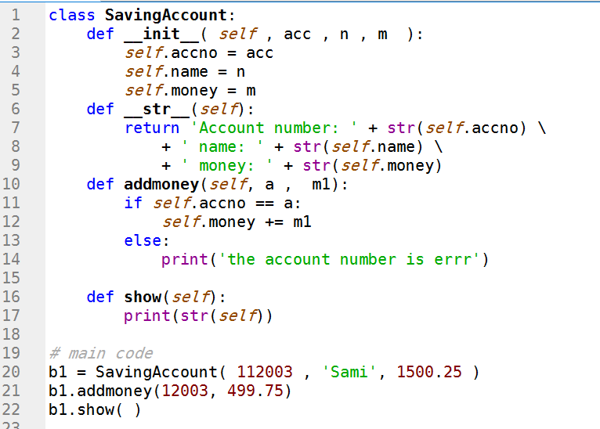
SavingAccount
+ accno : int (public)
+ name : string (public)
+ salary : int (public)
+ __init__( in acc , n ,m ): void
+ addmoney( in a:int , m1: float ): void
+ __str__ ( … ): String
+ show( … ): void

