Slide 1
Inheritance

Slide 2
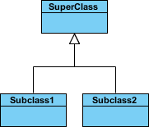
Python Inheritance
Inheritance allows us to define a class that inherits all accessible methods and properties from another class.
Parent class is the class being inherited from, also called base or super class.
Child class is the class that inherits from another class, also called derived or sub class.
MasterStds *is-a* Student.
PhDStds *is-a* Student
Student
parent
base
superClass
Master
Student
PhD
Student
child
derived
subClass

Slide 3
Create a Parent Class
Any class can be a parent class, so the syntax is the same as creating any other class:
Example: Create a class named Person, with firstname and lastname properties, and a printname method:
class Person: def __init__(self, fname, lname): self.firstname = fname self.lastname = lname def printName(self): print(self.firstname, self.lastname) #Use the Person class to create an object, and then execute the printname method: x = Person("John", "Doe") x.printName()

Slide 4
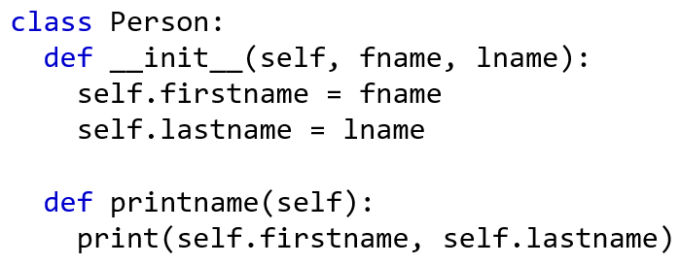
Create a Child Class
To create a class that inherits the functionality from another class, send the parent class as a parameter when creating the child class:
Example: Create a class named Student, which will inherit the properties and methods from the Person class
class Student(Person): pass
Note: Use the pass keyword when you do not want to add any other properties or methods to the class.
Now the Student class inherits the same properties and methods as the Person class.
Example: Use the Student class to create an object, and then execute the printName method:
x = Student("Mike", "Olsen") x.printName()

Slide 5
Add the __init__() Function
So far we have created a child class that inherits the properties and methods from its parent.
We want to add the __init__() function to the child class (instead of the pass keyword).
Note: The __init__() function is called automatically every time the class is being used to create a new object.
Example: Add the __init__() function to the Student class:
class Student(Person): def __init__(self, fname, lname): #add properties etc.
When you add the __init__() function, the child class will no longer inherit the parent's __init__() function.
Note: The child's __init__() function overrides the inheritance of the parent's __init__() function.
To keep the inheritance of the parent's __init__() function, add a call to the parent's __init__() function:

Slide 6
Example
class Student(Person): def __init__(self, fname, lname): Person.__init__(self, fname, lname)
Use the super() Function
Python also has a super() function that will make the child class inherit all the methods and properties from its parent:
Example
class Student(Person): def __init__(self, fname, lname): super().__init__(fname, lname)
By using the super() function, you do not have to use the name of the parent element, it will automatically inherit the methods and properties from its parent.

Slide 7
Add Properties
Example
Add a year parameter, and pass the correct year when creating objects:class Student(Person):
def __init__(self, fname, lname, year): super().__init__(fname, lname) self.graduationyear = year x = Student("Mike", "Olsen", 2023)

Slide 8
Add Methods
Example
Add a method called welcome to the Student class:
class Student(Person): def __init__(self, fname, lname, year): super().__init__(fname, lname) self.graduationyear = year def welcome(self): print("Welcome", self.firstname,self.lastname, "to the class, graduation year ", self.graduationyear)
If you add a method in the child class with the same name as in the parent class, the inheritance of the parent method will be overridden.

Slide 9
class Point2D(object):
def __init__(self,x,y): # constructor
self.x = x
self.y = y
def __str__(self):
return str(self.x) + ", " + str(self.y)
def show(self):
print(str(self))
class Point3D(Point2D):
def __init__(self, x, y, z): # constructor
Point2D.__init__(self, x, y)
self.z = z
def __str__(self):
return Point2D.__str__(self)+", "+ str(self.z)
def show(self):
print(str(self))
# main code
p3d= Point3D(2,3, 5)
p3d.show( )
The top class in Python is called object.
it is predefined by Python, always exists
use object when you have no superclass
Point2D
superclass
x : int
y : int
+ __init__(in x, y):void
+ __str__(out ): void
+ show( out ): void
subclass
Point3D
Master Std
Point4D
id = ..
major = ‘AI'
-------------------------
BAmajor = 'cs‘
Acc_Avg = 80.7
-------------------
x : int (inhert.)
y : int (inhert.)
z : int
+ __init__(in x, y,z):void
+ __str__(out ): void
+ show( out ): void

Slide 10
class Student(object):
def __init__(self , id, n , avg):
self.id = id
self.name = n
self.avg = avg
class MasterStd(Student):
def __init__(self, id, n , avg , mjr , mrk):
Student.__init__(self , id , n ,avg)
self.major = mjr
self.mark = mrk
def show(self):
print('id:', self.id , ' name:', self.name)
print(Bachelor avg=', self.avg)
print('Master major:',self.major, 'Marks=',self.mark)
# main code
m1 = MasterStd(2222, 'Sami', 91, 'AI', 87)
m1.show( )
Student
Master
Student
PhD
Student

Slide 11
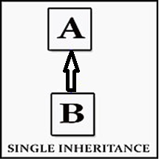
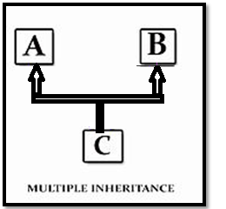
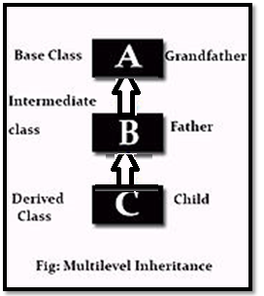
Types of Inheritance
3 types
Single Inheritance in Python
A single Python inheritance is when a single class inherits from a class.
2. Multiple Inheritance in Python
Multiple Python inheritance are when python class inherits from multiple classes.
3. Multilevel Inheritance in Python
When one class inherits from another, which in turn inherits from another, it is multilevel python inheritance.
Notes:
11

Slide 12
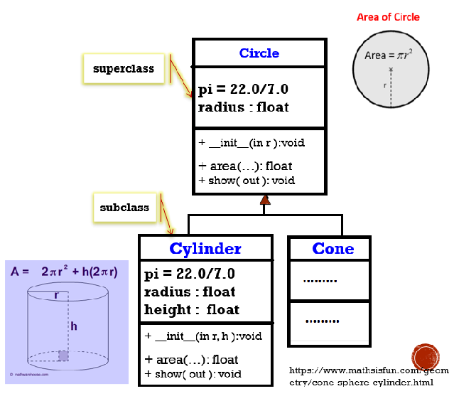
class Circle(object):
def __init__(…):
class Cylinder(Circle):
def __init__(…):
class Cone(Circle):
def __init__(…):
# main code

Slide 13
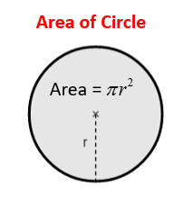
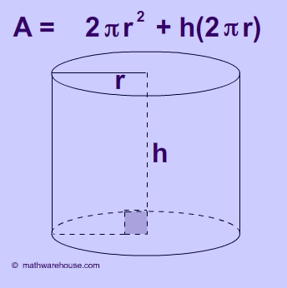
import math
class Circle(object):
def __init__(self,r):
self.r =r
def area(self):
return math.pi*self.r**2
def display(self):
print("Circle area is =",self.area( ))
class Cylinder(Circle):
def __init__(self,r,h):
self.h=h
Circle.__init__(self,r)
def area(self):
a= Circle.area(self)
return 2*a + self.h*(2*math.pi*self.r)
def display(self):
print("Cylinder area= ", self.area( ) )
# main code
c3= Circle(5)
print(c3.area( )) #← NO need to call
c3.display( )
c1= Cylinder(2,5)
c1.display( )

Slide 14
Inheritance Syntax (cont.)
A subclass inherits all accessible data and methods of its superclass
A subclass can override methods of the superclass
Just define a method of the same name
Notes:
14

Slide 15
overriding display function
class Parent:
x = 1
def display(self):
print( "x = ", self.x )
class Child(Parent):
y = 2
def display(self):
print( " x = ", self.x )
print( " y = ", self.y )
# main code
p1= Parent( )
p1.display()
ch1=Child( )
ch1.display( )
← overrding

Slide 16
Multiple Inheritance
Python supports multiple inheritance
In the class statement, replace the single superclass name with a comma-separated list of superclass names
Notes:
16

Slide 17
Multiple Inheritance
Python supports a limited form of multiple inheritance (applies depth-first, left-to-right rule)
class DerivedClass(Base1, Base2, Base3):
...
Python interprets this by applying the depth-first, left-to right rule: if an attribute is not found in DerivedClass, it is searched in Base1, then (recursively) in the base classes of Base1, and only if it is not found there, it is searched in Base2, and so on)
Notes:
17

Slide 18
class Person (object):
def __init__(self, n, a):
self.name = n
self.age = a
def show(self):
print('Name: ', self.name,\
'\nAge: ', self.age)
class Student (object):
def __init__(self, id):
self.stdId = id
def show(self):
print('ID: ', self.stdId)
class Resident ( Person, Student ):
def __init__(self, name, age, id):
Person.__init__(self, name, age)
Student.__init__(self, id)
# main code
r1 = Resident('Sami', 21, 20189022333)
r1.show()
Student.show(r1)

Slide 19
Multilevel Inheritance
In multilevel inheritance, we inherit the classes at multiple separate levels. We have three classes A, B and C, where A is the super class, B is its sub(child) class and C is the sub class of B.
Notes:
19

Slide 20
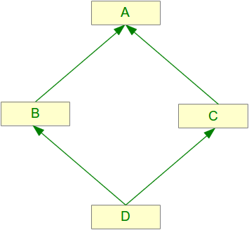
Multilevel Inheritance
Family
Father
Mother
"Mark"
"Sara"
Son
'Sami'
https://www.pythonprogramming.in/example-of-multilevel-inheritance-in-python.html
https://www.wikitechy.com/tutorials/python/multilevel-inheritance-in-python
https://www.javatpoint.com/inheritance-in-python
Notes:
20

Slide 21
Multilevel Inheritance
class Family(object):
def show_family(self):
print("This is our family:")
class Father(Family): # Father class inherited from Family
fathername = ""
def show_father(self):
return self.fathername
class Mother(Family): # Mother class inherited from Family
mothername = ""
def show_mother(self):
return self.mothername
class Son(Father, Mother): # Son class inherited from Father and Mother classes
sonName = 'Sami'
def show_parentSon(self):
print("Father :", self.show_father( ), " <--> Mother :", self.show_mother( ))
print("\n Son:", self.sonName )
# main code
s1 = Son() # Object of Son class
s1.fathername = "Mark"
s1.mothername = "Sara"
s1.show_family( )
s1.show_parentSon( )
Family
Father
Mother
"Mark"
“Sara"
Son
'Sami'
Notes:
21

Slide 22
Composition
22

Slide 23
What is the Difference between Inheritance and Composition?
In Inheritance, a class is inherited (extended) by a new sub-class that will add custom attributes and behavior to the inherited ones.
In Composition, a class is utilized by creating an instance of it, and including that instance inside another larger object.
To make it simpler and easier to remember, let’s say it in one sentence:
Inheritance extends (inherits) a class, while Composition uses an instance of the class
Notes:
23

Slide 24
Composition ➔ one class is composed from another class → real example
Car: Ford
Simple class
model: string
color: string
engine: Engine
tires: Wheel
year: int
1 … 1
Engine
size: string
6 Cylinder
company: string
GeneralMotor
class Engine(object):
def __init__(self, cmp, sz):
self.company = cmp
self.size = sz

Slide 25
engine1
class Engine(object):
def __init__(self, cmp, sz):
self.company = cmp
self.size = sz
def display(self):
return ('The engine from:',self.company, 'with size:',self.size)
class Car(object):
def __init__(self, mdl, yr, clr, eng):
self.model = mdl
self.year = yr
self.color = clr
self.engine = eng
def show(self):
print ('\n1- Car model:',self.model, ' car year:',self.year,\
' car color:',self.color,\
'\n\n 2- Engine:',self.engine.display(),)
# main code
engine1 = Engine('Ferrari','6 Cyl‘ )
c1 = Car('Chevrolet', 2019, 'Red', engine1)
c1.show( )
engine2 = Engine('opel','4 Cyl')
c2 = Car('Opel', 2010, 'White', engine2)
c2.show( )
company: 'Ferrari'
size: 6 Cyl
C1: Car1
model: 'Chevrolet'
color: 'Red
year: 2019
engine: engine1
engine1
size: 6 Cyl
company: 'Ferrari‘

