Slide 1

03 – Problem Solving by Searching: Uninformed (blind) search
Compiled by: Dr. Mohammad Alhawarat
Department of Computer Science
Faculty of Information Technology
Middle East University
Spring 2023

Slide 2

Agenda
Introduction
Problem-solving agents
Problem types
Problem formulation
Example problems
Basic search algorithms

Slide 3
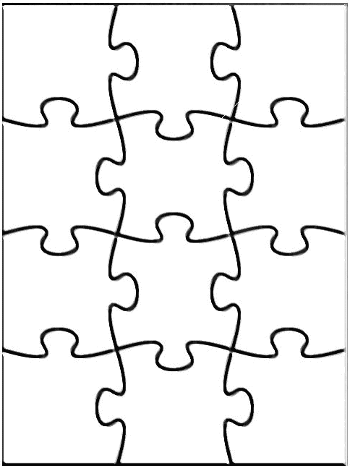
Agent
Declarative knowledge creates alternatives: ● Which pieces of knowledge to use? ● How to use them?
Search is a about exploring alternatives. It is a major approach to exploit knowledge
Perception
Robotics
Reasoning
Search
Learning
Knowledge rep.
Constraint satisfaction
Planning
Natural language
...
Expert
Systems

Slide 4
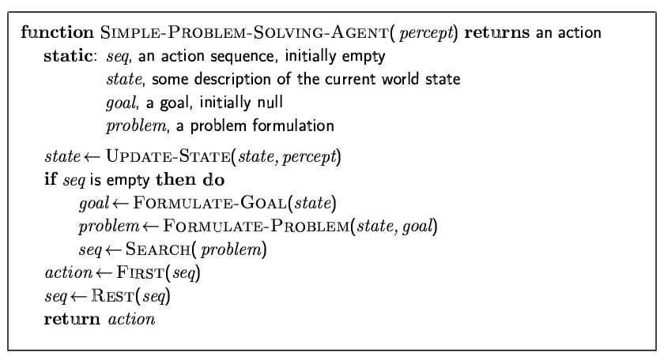

Problem-solving agents

Slide 5
Simple Problem-Solving-Agent Agent Algorithm
s₀ ← sense/read initial state
GOAL? ← select/read goal test
Succ ← read successor function
solution ← search(s₀, GOAL?, Succ)
perform(solution)

Slide 6
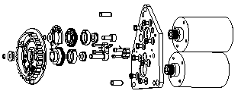
State Space
Each state is an abstract representation of a collection of possible worlds sharing some crucial properties and differing on non-important details only
E.g.: In assembly planning, a state does not define exactly the absolute position of each part
The state space is discrete. It may be finite, or infinite

Slide 7
Successor Function
It implicitly represents all the actions that are feasible in each state
Only the results of the actions (the successor states) and their costs are returned by the function
The successor function is a “black box”: its content is unknown E.g., in assembly planning, the successor function may be quite complex (collision, stability, grasping, ...)

Slide 8
Path Cost
An arc cost is a positive number measuring the “cost” of performing the action corresponding to the arc, e.g.:
1 in the 8-puzzle example
expected time to merge two sub-assemblies
We will assume that for any given problem the cost c of an arc always verifies: c ≥ ε > 0, where ε is a constant

Slide 9
Path Cost
An arc cost is a positive number measuring the “cost” of performing the action corresponding to the arc, e.g.:
1 in the 8-puzzle example
expected time to merge two sub-assemblies
We will assume that for any given problem the cost c of an arc always verifies: c ≥ ε > 0, where ε is a constant
[This condition guarantees that, if path becomes arbitrarily long, its cost also becomes arbitrarily large]
Why is this needed?

Slide 10
Data Structure of a Node
8
2
STATE
3
4
7
PARENT-NODE
5
1
6
BOOKKEEPING
CHILDREN
Action
Right
Depth
5
...
Path-Cost
5
Expanded
yes
Depth of a node N = length of path from root to N
(depth of the root = 0)

Slide 11
Node expansion
8
2
The expansion of a node N of the search tree consists of:
Evaluating the successor function on STATE(N)
Generating a child of N for each state returned by the function
node generation ≠ node expansion
3
4
7
5
1
6
N
8
2
8
4
2
8
2
3
4
7
3
7
3
4
7
5
1
6
5
1
6
5
1
6

Slide 12
Goal State
1
2
3
It may be explicitly described:
or partially described:
or defined by a condition, e.g., the sum of every row, of every column, and of every diagonal equals 30
4
5
6
7
8
1
a
a
a
5
a
a
8
a
(“a” stands for “any”
other than 1, 5, and 8)
15
1
2
12
4
10
9
7
8
6
5
11
3
13
14

Slide 13
Across history, puzzles and games requiring the exploration of alternatives have been considered a challenge for human intelligence:
Chess originated in Persia and India about 4000 years ago
Checkers appear in 3600-year-old Egyptian paintings
Go originated in China over 3000 years ago
So, it’s not surprising that AI uses games
to design and test algorithms

Slide 14
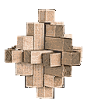

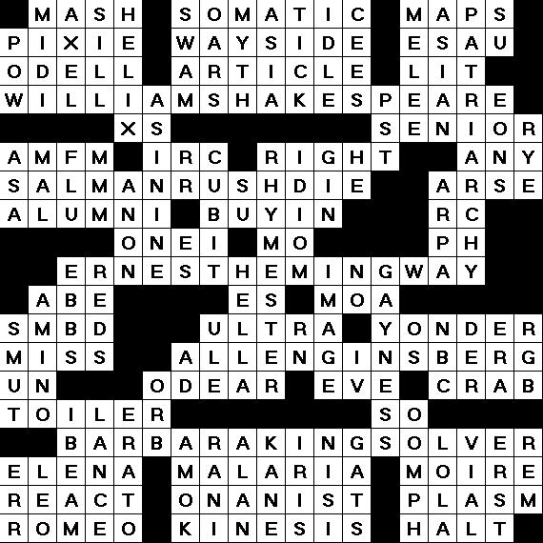
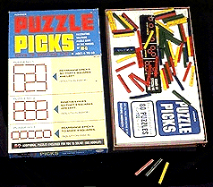
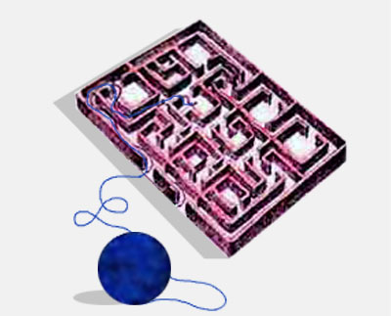
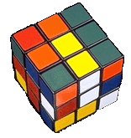
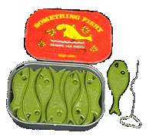
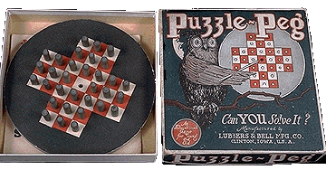

Slide 15
(n²-1)-puzzle
1
2
3
4
....
8
2
3
4
7
5
6
7
8
5
1
6
9
10
11
12
13
14
15

Slide 16
Example: 8-Puzzle
8
2
1
2
3
3
4
7
4
5
6
5
1
6
7
8
Initial state
Goal state
State: Any arrangement of 8 numbered tiles and an empty tile on a 3x3 board

Slide 17
8-Puzzle: Successor Function
8
2
7
SUCC(state) → subset of states
The successor function is knowledge about the 8-puzzle game, but it does
not tell us which outcome to use, nor to
which state of the board to apply it.
3
4
5
1
6
8
2
8
2
7
8
2
7
3
4
7
3
4
6
3
4
5
1
6
5
1
5
1
6
Search is about the exploration of alternatives

Slide 18
Fringe(Frontier) of Search Tree
The fringe is the set of all search nodes that haven’t been expanded yet
8
2
3
4
7
5
1
6
8
2
7
3
4
5
1
6
8
2
8
2
8
4
2
8
2
3
4
7
3
4
7
3
7
3
4
7
5
1
6
5
1
6
5
1
6
5
1
6

Slide 19

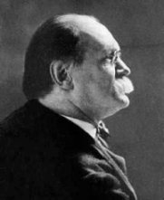
15-Puzzle
Introduced (?) in 1878 by Sam Loyd, who dubbed himself “America’s greatest puzzle-expert”

Slide 20
15-Puzzle
Sam Loyd offered $1,000 of his own money to the first person who would solve the following problem:
1
2
3
4
1
2
3
4
5
6
7
8
5
6
7
8
?
9
10
11
12
9
10
11
12
13
14
15
13
15
14

Slide 21
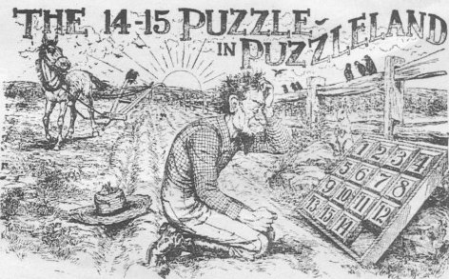
But no one ever won the prize !!

Slide 22
How big is the state space of the (n²-1)-puzzle?
8-puzzle → 9! = 362,880 states
15-puzzle → 16! ~ 2.09 x 10¹³ states
24-puzzle → 25! ~ 10²⁵ states
But only half of these states are reachable from any given state (but you may not know that in advance)

Slide 23
What is the Actual State Space?
The set of all states? [e.g., a set of 16! states for the 15-puzzle]
The set of all states reachable from a given initial state? [e.g., a set of 16!/2 states for the 15-puzzle]
In general, the answer is a) [because one does not know in advance which states are reachable]
But a fast test determining whether a state is reachable from another is very useful, as search techniques are often inefficient when a problem has no solution

Slide 24
Searching the State Space
It is often not feasible (or too expensive) to build a complete representation of the state graph

Slide 25
8-, 15-, 24-Puzzles
8-puzzle → 362,880 states
15-puzzle → 2.09 x 10¹³ states
24-puzzle → 10²⁵ states
0.036 sec
~ 55 hours
> 10⁹ years
100 millions states/sec

Slide 26
Searching the State Space
Often it is not feasible (or too expensive) to build a complete representation of the state graph
A problem solver must construct a solution by exploring a small portion of the graph

Slide 27
Searching the State Space
Search tree

Slide 28
Searching the State Space
Search tree

Slide 29
Searching the State Space
Search tree

Slide 30
Searching the State Space
Search tree

Slide 31
Searching the State Space
Search tree

Slide 32
Searching the State Space
Search tree

Slide 33
Representing a problem: The Formalism
To formulate a problem as a search problem we need the following components:
STATE SPACE: Formulate a state space over which we perform search. The state space is a way or representing in a computer the states of the real problem.
ACTIONS or STATE SPACE Transitions: Formulate actions that allow one to move between diﬀerent states. The actions reﬂect the actions one can take in the real problem but operate on the state space instead.

Slide 34
Representing a problem: The Formalism
To formulate a problem as a search problem we need the following components:
INITIAL or START STATE and GOAL: Identify the initial state that best represents the starting conditions, and the goal or condition one wants to achieve.
Heuristics: Formulate various heuristics to help guide the search process.

Slide 35
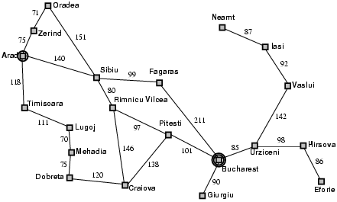
Example: Romania

Slide 36
Example: Romania
State space.
States: the various cities you could be located in.
Our abstraction: we are ignoring the low level details of driving, states where you are on the road between cities, etc.
Actions: drive between neighboring cities.
Initial state: in Arad
Desired condition (Goal): be in a state where you are in Bucharest. (How many states satisfy this condition?)
Solution will be the route, the sequence of cities to travel through to get to Bucharest.

Slide 37





















State-Space Problem Formulation
71
Oradea
A problem is defined by five items:
Neamt
75
Zerind 151
87
Iasi 92
Arad
140
Sibiu
99 Fagaras
initial state e.g., "at Arad“
118
Timisoara
80 Rimnicu Vilcea
97
Pitesti
Vaslui
111
211
142
70
Lugoj
85
98
Hirsova 86
actions Actions(s) = set of actions avail. in state s
Mehadia
120
146
101
Urziceni Bucharest
75
138
Dobreta
Cralova
90
Eforie
Giurgiu
transition model Results(s,a) = state that results from action a in states Alt: successor function S(x) = set of action–state pairs
– e.g., S(Arad) = {<Arad → Zerind, Zerind>, … }
goal test, (or goal state)
e.g., x = "at Bucharest”, Checkmate(x)
path cost (additive)
e.g., sum of distances, number of actions executed, etc.
c(x,a,y) is the step cost, assumed to be ≥ 0
A solution is a sequence of actions leading from the initial state to a goal state

Slide 38
Example: Romania
On holiday in Romania; currently in Arad.
Flight leaves tomorrow from Bucharest
Formulate goal:
be in Bucharest
Formulate problem:
states: various cities
actions: drive between cities
Find solution:
sequence of cities, e.g., Arad, Sibiu, Fagaras, Bucharest

Slide 39
Selecting a state space
Real world is absurdly complex; some abstraction is necessary to allow us to reason on it…
Selecting the correct abstraction and resulting state space is a difficult problem!
Abstract states ⬄ real-world states
Abstract operators ⬄ sequences or real-world actions
(e.g., going from city i to city j costs Lij ⬄ actually drive from city i to j)
Abstract solution ⬄ set of real actions to take in the
real world such as to solve problem

Slide 40
Last Lecture: Environment types
Environment | Accessible | Deterministic | Episodic | Static | Discrete
Operating System | Yes | Yes | No | No | Yes
Virtual Reality | Yes | Yes | Yes/No | No | Yes/No
Office Environment | No | No | No | No | No
Mars | No | Semi | No | Semi | No
The environment types largely determine the agent design.

Slide 41
Problem types
Classifying the environment:
Static / Dynamic
Previous problem was static: no attention to changes in environment
Deterministic / Stochastic
Previous problem was deterministic: no new percepts were necessary, we can predict the future perfectly
Observable / Partially Observable / Unobservable
Previous problem was observable: it knew the initial state, &c
Discrete / Continuous
Previous problem was discrete: we can enumerate all possibilities

Slide 42
Problem types
Deterministic, fully observable → single-state problem
Agent knows exactly which state it will be in; solution is a sequence
Non-observable → sensorless problem (multiple-state problem)
Agent may have no idea where it is; solution is a sequence
Nondeterministic and/or partially observable → contingency problem
percepts provide new information about current state
often interleave} search, execution
Unknown state space → exploration problem

Slide 43
Problem types
Single-state problem: deterministic, accessible
Agent knows everything about world, thus can
calculate optimal action sequence to reach goal state.
Multiple-state problem: deterministic, inaccessible
Agent must reason about sequences of actions and
states assumed while working towards goal state.
Contingency problem: nondeterministic, inaccessible
Must use sensors during execution
Solution is a tree or policy
Often interleave search and execution
Exploration problem: unknown state space
Discover and learn about environment while taking actions.

Slide 44
Problem types
Single-state problem: deterministic, accessible
Agent knows everything about world (the exact state),
Can calculate optimal action sequence to reach goal state.
E.g., playing chess. Any action will result in an exact state

Slide 45
Problem types
Multiple-state problem: deterministic, inaccessible
Agent does not know the exact state (could be in any of the possible states)
May not have sensor at all
Assume states while working towards goal state.
E.g., walking in a dark room
If you are at the door, going straight will lead you to the kitchen
If you are at the kitchen, turning left leads you to the bedroom
…

Slide 46
Problem types
Contingency problem: nondeterministic, inaccessible
Must use sensors during execution
Solution is a tree or policy
Often interleave search and execution
E.g., a new skater in an arena
Sliding problem.
Many skaters around

Slide 47
Problem types
Exploration problem: unknown state space
Discover and learn about environment while taking actions.
E.g., Maze

Slide 48
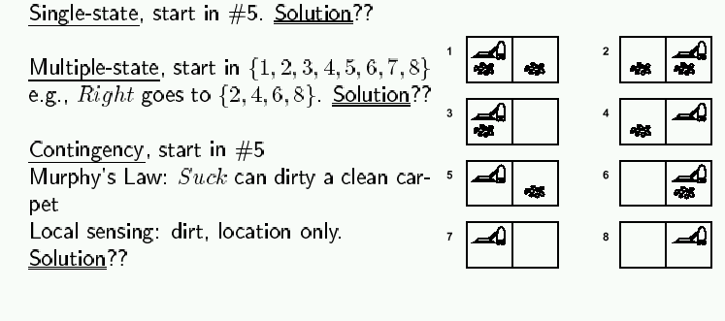
Example: Vacuum world
Simplified world: 2 locations, each may or not contain dirt,
each may or not contain vacuuming agent.
Goal of agent: clean up the dirt.

Slide 49
Last time: Problem-Solving
Problem solving:
Goal formulation
Problem formulation (states, operators)
Search for solution
Problem formulation:
Initial state
Operators
Goal test
Path cost
Problem types:
single state: accessible and deterministic environment
multiple state: inaccessible and deterministic environment
contingency: inaccessible and nondeterministic environment
exploration: unknown state-space

Slide 50
The Formalism
Once the problem has been formulated as a state space search, various algorithms can be utilized to solve the problem.
A solution to the problem will be a sequence of actions/moves that can transform your current state into a state where your desired condition holds.

Slide 51
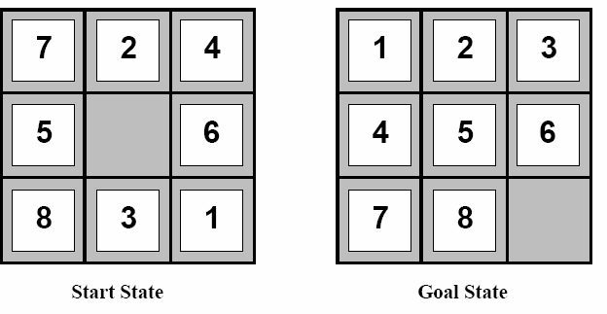
Example: The 8-­‐Puzzle
Rule: Can slide a tile into the blank spot.
Alternative view: move the blank spot around.

Slide 52
Example: The 8-­‐Puzzle
State space.
States: The diﬀerent configurations of the tiles. How many diﬀerent states?
Actions: Moving the blank up, down, left, right. Can every action be performed in every state?
Initial state: e.g., state shown on previous slide.
Desired condition (Goal): be in a state where the tiles are all in the positions shown on the previous slide.
Solution will be a sequence of moves of the blank that transform the initial state to a goal state.

Slide 53
Example: The 8-­‐Puzzle
Although there are 9! diﬀerent configurations of the tiles (362,880) in fact the state space is divided into two disjoint parts.
Only when the blank is in the middle are all four actions possible.
Our goal condition is satisfied by only a single state. But one could easily have a goal condition like
The 8 is in the upper left hand corner.
How many diﬀerent states satisfy this goal?

Slide 54
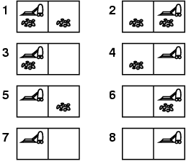
Example: vacuum world
Single-state, start in #5. Solution?

Slide 55
Example: vacuum world
Single-state, start in #5. Solution? [Right, Suck]
Sensorless, start in {1,2,3,4,5,6,7,8} e.g., Right goes to {2,4,6,8} Solution?

Slide 56
Example: vacuum world
Sensorless, start in {1,2,3,4,5,6,7,8} e.g., Right goes to {2,4,6,8} Solution? [Right,Suck,Left,Suck]
Contingency
Nondeterministic: Suck may dirty a clean carpet
Partially observable: location, dirt at current location.
Percept: [L, Clean], i.e., start in #5 or #7 Solution?

Slide 57
Example: vacuum world
Sensorless, start in {1,2,3,4,5,6,7,8} e.g., Right goes to {2,4,6,8} Solution? [Right,Suck,Left,Suck]
Contingency
Nondeterministic: Suck may dirty a clean carpet
Partially observable: location, dirt at current location.
Percept: [L, Clean], i.e., start in #5 or #7 Solution? [Right, if dirt then Suck]

Slide 58
Single-state problem formulation
A problem is defined by four items:
initial state e.g., "at Arad"
actions or successor function S(x) = set of action–state pairs
e.g., S(Arad) = {<Arad → Zerind, Zerind>, … }
goal test, can be
explicit, e.g., x = "at Bucharest"
implicit, e.g., Checkmate(x)
path cost (additive)
e.g., sum of distances, number of actions executed, etc.
c(x,a,y) is the step cost, assumed to be ≥ 0
A solution is a sequence of actions leading from the initial state to a goal state

Slide 59
Selecting a state space
Real world is absurdly complex
→ state space must be abstracted for problem solving
(Abstract) state = set of real states
(Abstract) action = complex combination of real actions
e.g., "Arad → Zerind" represents a complex set of possible routes, detours, rest stops, etc.
For guaranteed realizability, any real state "in Arad“ must get to some real state "in Zerind"
(Abstract) solution =
set of real paths that are solutions in the real world
Each abstract action should be "easier" than the original problem

Slide 60
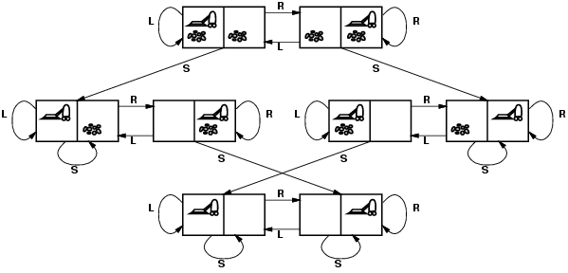
Vacuum world state space graph
states?
actions?
goal test?
path cost?

Slide 61
Vacuum world state space graph
states? integer dirt and robot location
actions? Left, Right, Suck
goal test? no dirt at all locations
path cost? 1 per action

Slide 62
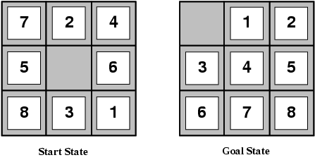
Example: The 8-puzzle
states?
actions?
goal test?
path cost?

Slide 63
Example: The 8-puzzle
states? locations of tiles
actions? move blank left, right, up, down
goal test? = goal state (given)
path cost? 1 per move
[Note: optimal solution of n-Puzzle family is NP-hard]

Slide 64
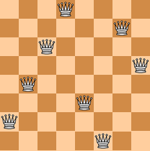
Ex: 8-Queens
Place as many queens as possible
on the chess board without capture
states? - any arrangement of n<=8 queens
- or arrangements of n<=8 queens in leftmost n columns, 1 per column, such that no queen attacks any other.
initial state? no queens on the board
actions? - add queen to any empty square
- or add queen to leftmost empty square such that it is not attacked by other queens.
goal test?
path cost? 1 per move (not relevant…)
8 queens on the board, none attacked.

Slide 65
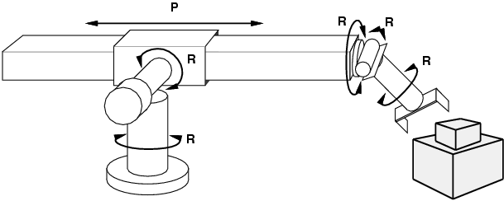
Example: robotic assembly
states?: real-valued coordinates of robot joint angles parts of the object to be assembled
actions?: continuous motions of robot joints
goal test?: complete assembly
path cost?: time to execute

Slide 66

Search Problems

Slide 67
Architectures for Intelligence
Search?
Determine how to achieve some goal; “what to do”
Logic & inference?
Reason about what to do
Encode knowledge / “expert” systems
Know what to do
Learning?
Learn what to do
Modern view: complex & multi-faceted

Slide 68
What is Search?
Search is a class of techniques for systematically finding or constructing solutions to problems.
Example technique: generate-and-test.
Example problem: Combination lock.
Generate a possible solution.
Test the solution.
If solution found THEN done ELSE return to step 1.

Slide 69
Why is search interesting?
Many (all?) AI problems can be formulated as search problems!
Examples:
Path planning
Games
Natural Language Processing
Machine learning
…

Slide 70
Applications
Search plays a key role in many applications, e.g.:
Route finding: airline travel, networks
Package/mail distribution
Pipe routing, VLSI routing
Comparison and classification of protein folds
Pharmaceutical drug design
Design of protein-like molecules
Video games

Slide 71

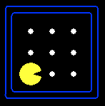





Search Problems
A search problem consists of:
A state space
For each state, a set
Actions(s) of allowable actions
A transition model Result(s,a)
A step cost function c(s,a,s’)
A start state and a goal test
A solution is a sequence of actions (a plan) which transforms the start state to a goal state
{N, E}
1
N
E
1
Notes:
Often comes back on exams
Goal test – sometimes more than one state that satisfies having achieved the goal, for example, “eat all the dots”
Abstraction

Slide 72
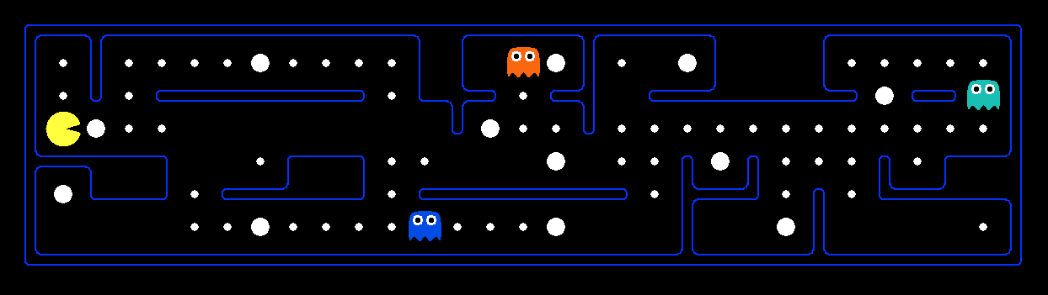
What’s in a State Space?
The real world state includes every last detail of the environment
A search state abstracts away details not needed to solve the problem
Problem: Pathing
State representation: (x,y) location
Actions: NSEW
Transition model: update location
Goal test: is (x,y)=END
Problem: Eat-All-Dots
State representation: {(x,y), dot booleans}
Actions: NSEW
Transition model: update location and possibly a dot boolean
Goal test: dots all false
Notes:
Wrong example for “eat-all-dots”: (x, y, dot count)

Slide 73
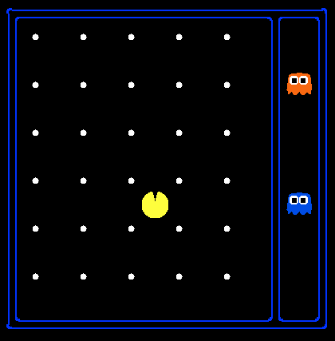
State Space Sizes?
World state:
Agent positions: 120
Food count: 30
Ghost positions: 12
Agent facing: NSEW
How many
World states?
120x(2³⁰)x(12²)x4
States for pathing?
120
States for eat-all-dots?
120x(2³⁰)
Notes:
90 * (2^30-1) + 30 * 2^29 = 145 billion
2^29 = 536 870 912

Slide 74
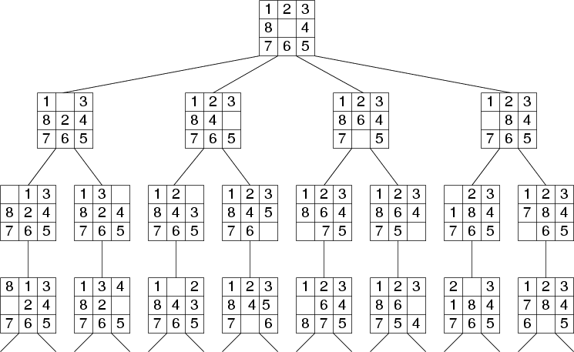
Search Tree Example: Fragment of 8-Puzzle Problem Space

Slide 75
Blind vs. Heuristic Strategies
Blind (or un-informed) strategies do not exploit state descriptions to order FRINGE. They only exploit the positions of the nodes in the search tree
Heuristic (or informed) strategies exploit state descriptions to order FRINGE (the most “promising” nodes are placed at the beginning of FRINGE)

Slide 76
Uninformed (Blind) search strategies
Uninformed search strategies use only the information available in the problem definition
Breadth-first search
Depth-first search
Depth-limited search
Iterative deepening search

Slide 77
Search
Formulate “what to do” as a search problem
Solution tells the agent what to do
If no solution in the current search space?
Find space that does contain a solution (use search!)
Solve original problem in new search space
Many powerful extensions to these ideas
Constraint satisfaction; planning; game playing; …
Human problem-solving often looks like search

Slide 78
Why Search can be difficult
At the start of the search, the search algorithm does not know
the size of the tree
the shape of the tree
the depth of the goal states
How big can a search tree be?
say there is a constant branching factor b
and one goal exists at depth d
search tree which includes a goal can have
b^{d} different branches in the tree (worst case)
Examples:
– b = 2, d = 10:
– b = 10, d = 10:
b^{d} = 2¹⁰= 1024
b^{d} = 10¹⁰= 10,000,000,000

Slide 79
Uninformed Search Strategies
These are strategies that adopt a fixed rule for selecting the next state to be expanded.
The rule does not change irrespective of the search problem being solved.
These strategies do not take into account any domain specific information about the particular search problem.
Uninformed search techniques:
Breadth-­‐First, Uniform-­‐Cost, Depth-­‐First, Depth-­‐Limited, and Iterative-­‐ Deepening search

Slide 80
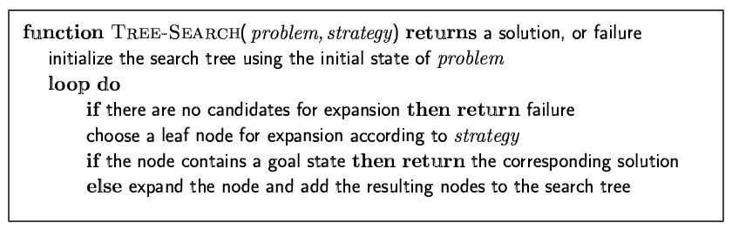
Tree search algorithms
Basic idea:
offline, simulated exploration of state space by generating successors of already-explored states (a.k.a.~expanding states)

Slide 81
Search Strategy
The fringe is the set of all search nodes that haven’t been expanded yet
The fringe is implemented as a priority queue FRINGE
INSERT(node,FRINGE)
REMOVE(FRINGE)
The ordering of the nodes in FRINGE defines the search strategy

Slide 82
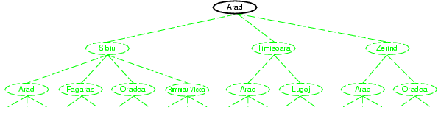
Tree search example

Slide 83
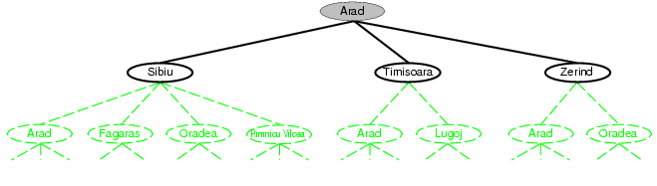
Tree search example

Slide 84
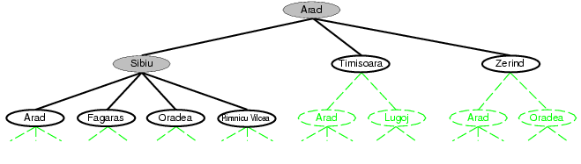
Tree search example

Slide 85
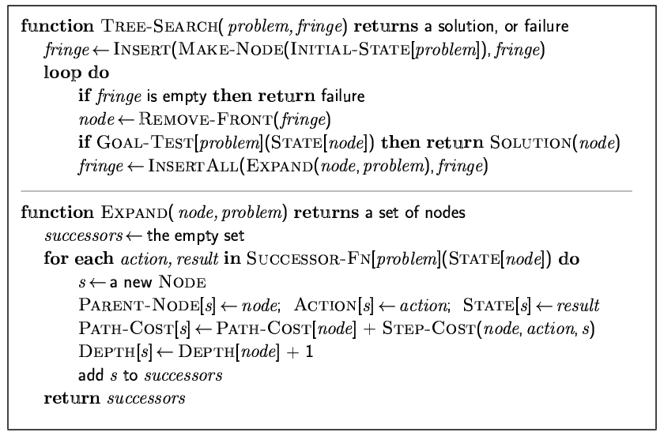
Implementation: general tree search

Slide 86
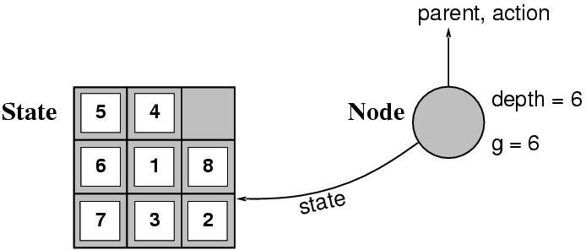
Implementation: states vs. nodes
A state is a (representation of) a physical configuration
A node is a data structure constituting part of a search tree includes state, parent node, action, path cost g(x), depth
The Expand function creates new nodes, filling in the various fields and using the SuccessorFn of the problem to create the corresponding states.

Slide 87
Search strategies
A search strategy is defined by picking the order of node expansion
Strategies are evaluated along the following dimensions:
completeness: does it always find a solution if one exists?
time complexity: number of nodes generated
space complexity: maximum number of nodes in memory
optimality: does it always find a least-cost solution?
Time and space complexity are measured in terms of
b: maximum branching factor of the search tree
d: depth of the least-cost solution
m: maximum depth of the state space (may be ∞)

Slide 88
Evaluation of search strategies
A search strategy is defined by picking the order of node expansion.
Search algorithms are commonly evaluated according to the following four criteria:
Completeness: does it always find a solution if one exists?
Time complexity: how long does it take as function of num. of nodes?
Space complexity: how much memory does it require?
Optimality: does it guarantee the least-cost solution?
Time and space complexity are measured in terms of:
b – max branching factor of the search tree
d – depth of the least-cost solution
m – max depth of the search tree (may be infinity)

Slide 89
Time complexity
If a goal node is found on depth d of the tree, all nodes up till that depth are created.
d
m
b
G
Thus: O(b^{d})

Slide 90
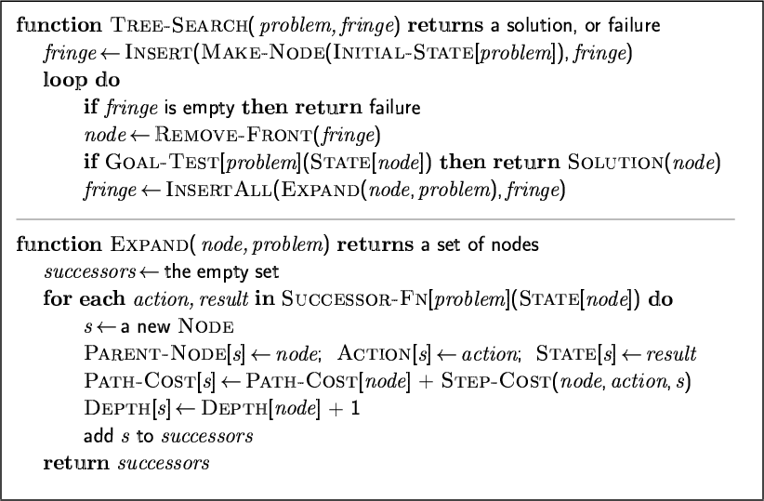
General tree search
Goal test after pop

Slide 91
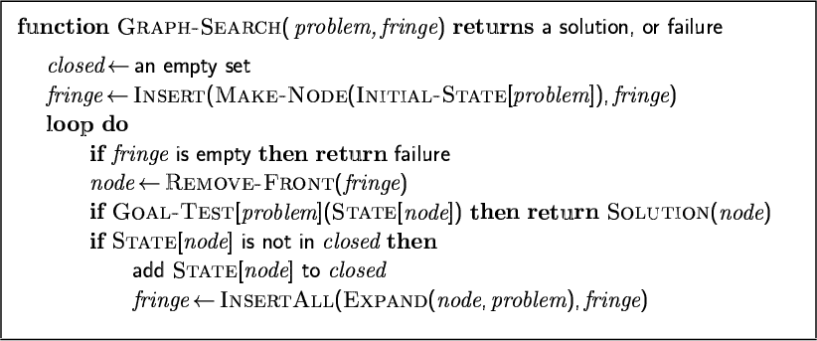
General graph search
Goal test after pop

Slide 92
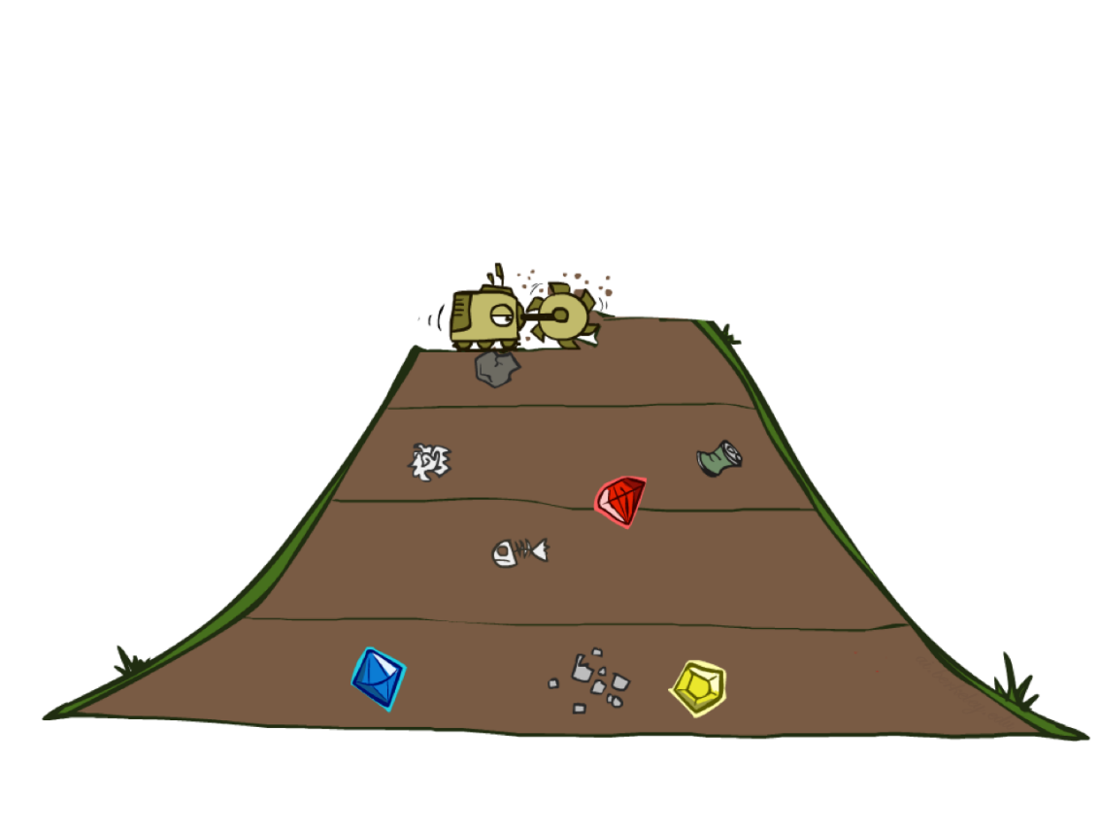
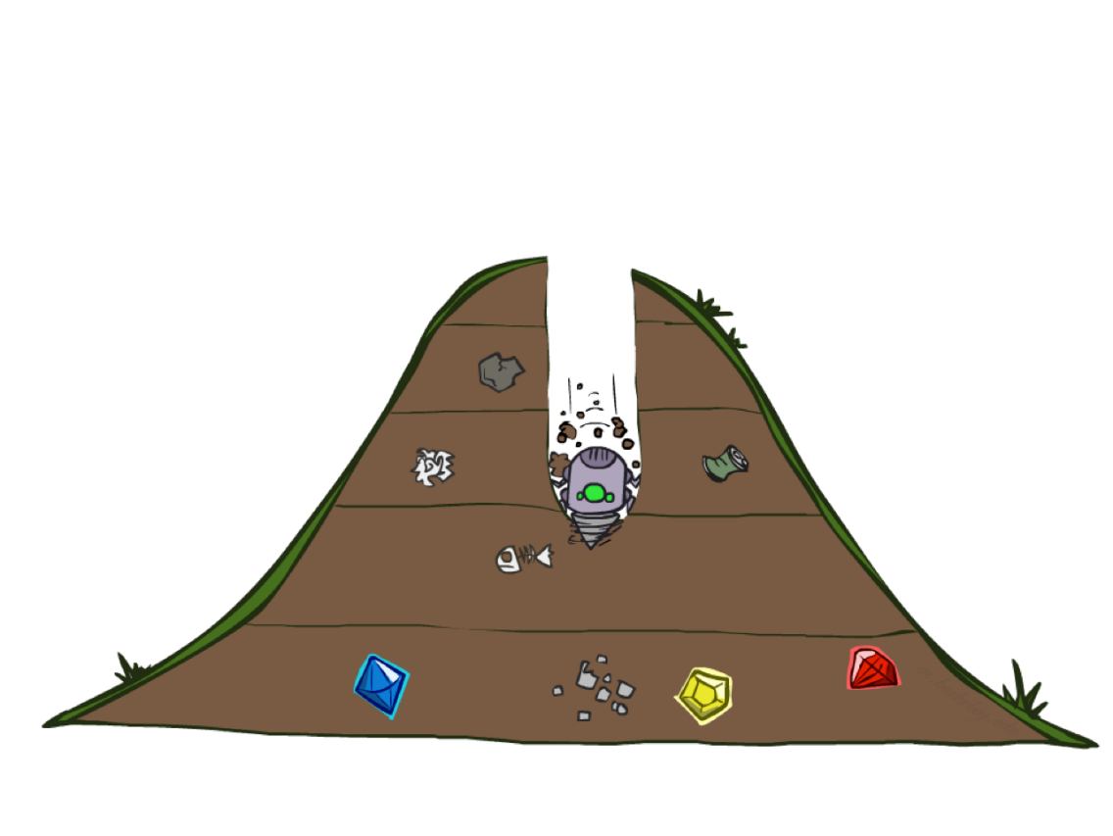
BFS vs DFS

Slide 93
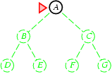
Breadth-first search
Expand shallowest unexpanded node
Implementation:
fringe is a FIFO queue, i.e., new successors go at end

Slide 94
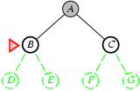
Breadth-first search
Expand shallowest unexpanded node
Implementation:
fringe is a FIFO queue, i.e., new successors go at end

Slide 95
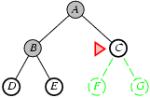
Breadth-first search
Expand shallowest unexpanded node
Implementation:
fringe is a FIFO queue, i.e., new successors go at end

Slide 96
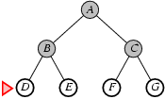
Breadth-first search
Expand shallowest unexpanded node
Implementation:
fringe is a FIFO queue, i.e., new successors go at end

Slide 97
Properties of breadth-first search
Complete? Yes (if b is finite)
Time? 1+b+b²+b³+… +b^{d} + b(b^{d}-1) = O(b^{d+1})
Space? O(b^{d+1}) (keeps every node in memory)
Optimal? Yes (if cost = 1 per step)
Space is the bigger problem (more than time)

Slide 98
Uniform-cost search
Breadth-first is only optimal if path cost is a non-decreasing function of depth, i.e., f(d) ≥ f(d-1); e.g., constant step cost, as in the 8- puzzle.
Can we guarantee optimality for variable positive step costs ≥ε? (Why ≥ε? To avoid infinite paths w/ step costs 1, ½, ¼, …)
Uniform-cost Search:
Expand node with smallest path cost g(n).
Frontier is a priority queue, i.e., new successors are merged into the queue sorted by g(n).
Can remove successors already on queue w/higher g(n).
Saves memory, costs time; another space-time trade-off.
Goal-Test when node is popped off queue.

Slide 99
Uniform-cost search
Implementation: Frontier = queue ordered by path cost. Equivalent to breadth-first if all step costs all equal.
Complete? Yes, if b is finite and step cost ≥ ε > 0.
(otherwise it can get stuck in infinite loops)
Time? # of nodes with path cost ≤ cost of optimal solution. _{O(b}⎣1+C*/ε⎦_{) ≈ O(b}d+1₎
Space? # of nodes with path cost ≤ cost of optimal solution. _{O(b}⎣1+C*/ε⎦_{) ≈ O(b}d+1_{).}
Optimal? Yes, for any step cost ≥ ε > 0.

Slide 100
Uniform-cost search
Proof of Completeness:
Assume (1) finite max branching factor = b; (2) min step cost ≥
ε > 0; (3) cost to optimal goal = C*. Then a node at depth ⎣ 1+C*/ε ⎦ must have a path cost > C*. There are O( b^( ⎣ 1+C*/ε ⎦ ) such nodes, so a goal will be found.
Proof of Optimality (given completeness):
Suppose that UCS is not optimal. Then there must be an (optimal) goal state with path cost smaller than the found (suboptimal) goal state (invoking completeness).
However, this is impossible because UCS would have expanded that node first, by definition.
Contradiction.

Slide 101
Ex: Uniform-cost search
(Search tree version)
1
A 10
Order of node expansion: Path found: Cost of path found:
S ⁵ B ⁵ G
15 C 5
Route finding problem. Steps labeled w/cost.
S
g=0

Slide 102
Ex: Uniform-cost search
(Search tree version)
1
A 10
Order of node expansion: S Path found: Cost of path found:
S ⁵ B ⁵ G
15 C 5
Route finding problem. Steps labeled w/cost.
S
g=0
A
g=1
B
g=5
C g=15

Slide 103
Ex: Uniform-cost search
(Search tree version)
1
A 10
S ⁵ B ⁵ G
15 C 5
Order of node expansion: S A Path found: Cost of path found:
Route finding problem. Steps labeled w/cost.
S
g=0
This early expensive goal node will go back onto the queue until after the later cheaper goal is found.
A
g=1
B
g=5
C g=15
G g=11

Slide 104


Ex: Uniform-cost search
(Search tree version)
1
A 10
Order of node expansion: S A B Path found: Cost of path found:
S ⁵ B ⁵ G
15 C 5
Route finding problem. Steps labeled w/cost.
S
g=0
A
g=1
B
g=5
C g=15
G g=11
G g=10
Remove the higher-cost of identical nodes and save memory. However, UCS is optimal even if this is not done, since lower- cost nodes sort to the front.

Slide 105
Ex: Uniform-cost search
(Search tree version)
1
A 10
S ⁵ B ⁵ G
15 C 5
Order of node expansion: S A B G Path found: S B G Cost of path found: 10
Route finding problem. Steps labeled w/cost.
S
g=0
A
g=1
B
g=5
C g=15
G g=11
G g=10
Technically, the goal node is not really expanded, because we do not generate the children of a goal node. It is listed in “Order of node expansion” only for your convenience, to see explicitly where it was found.

Slide 106
Ex: Uniform-cost search
(Virtual queue version)
1
A 10
Order of node expansion: Path found: Cost of path found:
S ⁵ B ⁵ G
15 C 5
Route finding problem. Steps labeled w/cost.
Expanded: Next: Children: Queue: S/g=0

Slide 107
Ex: Uniform-cost search
(Virtual queue version)
1
A 10
Order of node expansion: S Path found: Cost of path found:
S ⁵ B ⁵ G
15 C 5
Route finding problem. Steps labeled w/cost.
Expanded: S/g=0
Next: S/g=0
Children: A/g=1, B/g=5, C/g=15 Queue: A/g=1, B/g=5, C/g=15
S/g=0,

Slide 108
Ex: Uniform-cost search
1
A 10
(Virtual queue version)
S ⁵ B ⁵ G
15 C 5
Order of node expansion: S A Path found: Cost of path found:
Route finding problem. Steps labeled w/cost.
Expanded: S/g=0, A/g=1
Next: A/g=1
Children: G/g=11
Queue: , B/g=5, C/g=15, G/g=11
S/g=0,
A/g=1
Note that in a proper priority queue in a computer system, this queue would be sorted by g(n). For hand-simulated search it is more convenient to write children as they occur, and then scan the current queue to pick the highest-priority node on the queue.

Slide 109
Ex: Uniform-cost search
(Virtual queue version)
1
A 10
Order of node expansion: S A B Path found: Cost of path found:
S ⁵ B ⁵ G
15 C 5
Route finding problem. Steps labeled w/cost.
Expanded: S/g=0, A/g=1, B/g=5
Next: B/g=5
Children: G/g=10
Queue: , , C/g=15, G/g=11,
S/g=0,
A/g=1
B/g=5
G/g=10
Remove the higher-cost of identical nodes and save memory. However, UCS is optimal even if this is not done, since lower- cost nodes sort to the front.

Slide 110
Ex: Uniform-cost search
(Virtual queue version)
1
A 10
Order of node expansion: S A B G Path found: S B G Cost of path found: 10
S ⁵ B ⁵ G
15 C 5
Route finding problem. Steps labeled w/cost.
The same “Order of node expansion”, “Path found”, and “Cost of path found” is obtained by both methods. They are formally equivalent to each other in all ways.
Expanded: S/g=0, A/g=1, B/g=5, G/g=10
Next: G/g=10
Children: none
Queue: , , C/g=15, G/g=11,
S/g=0,
A/g=1
B/g=5
G/g=10
Technically, the goal node is not really expanded, because we do not generate the children of a goal node. It is listed in “Order of node expansion” only for your convenience, to see explicitly where it was found.

Slide 111
6 _{D} 1
3
A
F
1
S
2
4
8
G
B
E
1
20
C
The graph above shows the step-costs for different paths going from the start (S) to the goal (G).
Use uniform cost search to find the optimal path to the goal.
Exercise for home

Slide 112
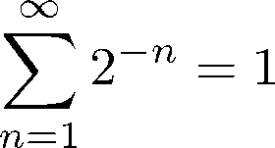
Uniform cost search
Why require step cost ≥ ε > 0?
Otherwise, an infinite regress is possible.
Recall:
S is the start node.
S
cost(S,A) = 1/2 g(A) = 1/2
cost(A,B) = 1/4
A
g(B) = 3/4
cost(B,C) = 1/8
cost(S,G) = 1
B
g(C) = 7/8
cost(C,D) = 1/16
g(C) = 15./1.6.
D
G g(G) = 1
C
G is the only goal node in the search space
No return from this branch. G will never be popped.

Slide 113
Uniform-cost search
Expand least-cost unexpanded node
Implementation:
fringe = queue ordered by path cost
Equivalent to breadth-first if step costs all equal
Complete? Yes, if step cost ≥ ε
Time? # of nodes with g ≤ cost of optimal solution, O(b^{ceiling(C*/ ε)}) where C* is the cost of the optimal solution
Space? # of nodes with g ≤ cost of optimal solution, O(b^{ceiling(C*/ ε)})
Optimal? Yes – nodes expanded in increasing order of g(n)

Slide 114
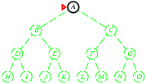
Depth-first search
Expand deepest unexpanded node
Implementation:
fringe = LIFO queue, i.e., put successors at front

Slide 115
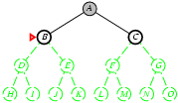
Depth-first search
Expand deepest unexpanded node
Implementation:
fringe = LIFO queue, i.e., put successors at front

Slide 116
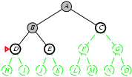
Depth-first search
Expand deepest unexpanded node
Implementation:
fringe = LIFO queue, i.e., put successors at front

Slide 117
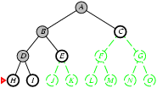
Depth-first search
Expand deepest unexpanded node
Implementation:
fringe = LIFO queue, i.e., put successors at front

Slide 118
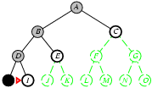
Depth-first search
Expand deepest unexpanded node
Implementation:
fringe = LIFO queue, i.e., put successors at front

Slide 119
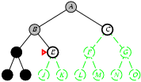
Depth-first search
Expand deepest unexpanded node
Implementation:
fringe = LIFO queue, i.e., put successors at front

Slide 120
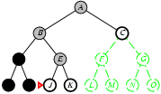
Depth-first search
Expand deepest unexpanded node
Implementation:
fringe = LIFO queue, i.e., put successors at front

Slide 121
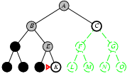
Depth-first search
Expand deepest unexpanded node
Implementation:
fringe = LIFO queue, i.e., put successors at front

Slide 122
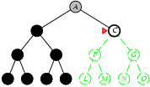
Depth-first search
Expand deepest unexpanded node
Implementation:
fringe = LIFO queue, i.e., put successors at front

Slide 123
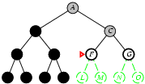
Depth-first search
Expand deepest unexpanded node
Implementation:
fringe = LIFO queue, i.e., put successors at front

Slide 124
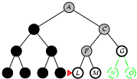
Depth-first search
Expand deepest unexpanded node
Implementation:
fringe = LIFO queue, i.e., put successors at front

Slide 125

Depth-first search
Expand deepest unexpanded node
Implementation:
fringe = LIFO queue, i.e., put successors at front

Slide 126
Properties of depth-first search
Complete? No: fails in infinite-depth spaces, spaces with loops
Modify to avoid repeated states along path
→ complete in finite spaces
Time? O(b^{m}): terrible if m is much larger than d
but if solutions are dense, may be much faster than breadth-first
Space? O(bm), i.e., linear space!
Optimal? No

Slide 127

Depth-limited search
= depth-first search with depth limit L,
i.e., nodes at depth l have no successors
Recursive implementation:

Slide 128
Depth Limited Search
Breadth first has space problems. Depth first can run oﬀ down a very long (or infinite) path.
Depth limited search
Perform depth first search but only to a pre-­‐specified depth limit D.
THE ROOT is at DEPTH 0. ROOT is a path of length 1.
No node representing a path of length more than D+1 is placed on OPEN.
We “truncate” the search by looking only at paths of length D+1 or less.
Now infinite length paths are not a problem.
But will only find a solution if a solution of DEPTH ≤ D exists.

Slide 129
Depth Limited Search
DLS(OPEN, Successors, Goal?) /* Call with OPEN = {<START>} */ WHILE(OPEN not EMPTY) {
n= select first node from OPEN Curr = terminal state of n If(Goal?(Curr)) return n
If Depth(n) < D //Don't add successors if Depth(n) = D
OPEN = (OPEN– {n}) U_{s ∈ Successors(Curr)}<n,s>
OPEN = OPEN – {n}
CutOffOccured = TRUE.
Else
}
return FAIL

Slide 130

Depth Limited Search Example

Slide 131

Iterative deepening search

Slide 132

Iterative deepening search l =0

Slide 133

Iterative deepening search l =1

Slide 134

Iterative deepening search l =2

Slide 135

Iterative deepening search l =3

Slide 136
Iterative deepening search
Number of nodes generated in a depth-limited search to depth d with branching factor b:
N_{DLS} = b⁰ + b¹ + b² + … + b^{d-2} + b^{d-1} + b^{d}
Number of nodes generated in an iterative deepening search to depth d with branching factor b:
N_{IDS} = (d+1)b⁰ + d b^¹ + (d-1)b^² + … + 3b^{d-2} +2b^{d-1} + 1b^{d}
For b = 10, d = 5,
N_{DLS} = 1 + 10 + 100 + 1,000 + 10,000 + 100,000 = 111,111
N_{IDS} = 6 + 50 + 400 + 3,000 + 20,000 + 100,000 = 123,456
Overhead = (123,456 - 111,111)/111,111 = 11%

Slide 137
Properties of iterative deepening search
Complete? Yes
Time? (d+1)b⁰ + d b¹ + (d-1)b² + … + b^{d} = O(b^{d})
Space? O(bd)
Optimal? Yes, if step cost = 1

Slide 138

Summary of algorithms

Slide 139

Repeated states
Failure to detect repeated states can turn a linear problem into an exponential one!

Slide 140

Graph search

Slide 141
State Space Graphs
State space graph: A mathematical representation of a search problem
Nodes are (abstracted) world configurations
Arcs represent transitions resulting from actions
The goal test is a set of goal nodes (maybe only one)
In a state space graph, each state occurs only once!
We can rarely build this full graph in memory (it’s too big), but it’s a useful idea

Slide 142


Graph Search
This graph search algorithm overlays a tree on a graph
The frontier states separate the explored states from never seen states

Slide 143
Avoiding Revisited States
Requires comparing state descriptions
Breadth-first search:
Store all states associated with generated nodes in VISITED
If the state of a new node is in VISITED, then discard the node

Slide 144

Repeated states
Failure to detect repeated states can turn a linear problem into an exponential one!
•

Slide 145
Problem
All these methods are slow (blind)
Solution → add guidance (“heuristic estimate”)
→ “informed search”

Slide 146
Summary
Problem formulation usually requires abstracting away real-world details to define a state space that can be explored using computer algorithms.
Once problem is formulated in abstract form, complexity analysis helps us picking out best algorithm to solve problem.
Variety of uninformed search strategies; difference lies in method used to pick node that will be further expanded.
Iterative deepening search only uses linear space and not much more time than other uniformed search strategies.

Slide 147

Questions

