Slide 1

06 – Adversarial Search and Games
Compiled by: Dr. Mohammad Alhawarat
Department of Computer Science
Faculty of Information Technology
Middle East University
Spring 2023

Slide 2

Agenda
Adversarial Games
The minimax algorithm
Resource Limits
alpha-beta pruning

Slide 3
Last time: Local search
Local Search:
Iterative Improvement
Hill-climbing
Simulated annealing
Genetic Algorithms
Gradient methods

Slide 4
This time: Game Playing and Adversarial Search
Adversarial search:
Adversarial Games
The minimax algorithm
Resource Limits
alpha-beta pruning

Slide 5
What kind of games?
Abstraction: To describe a game we must capture every relevant aspect of the game. Such as:
Chess
Tic-tac-toe
…
Accessible environments: Such games are characterized by perfect information
Search: game-playing then consists of a search through possible game positions
Unpredictable opponent: introduces uncertainty thus game-playing must deal with contingency problems

Slide 6
Searching for the next move
Complexity: many games have a huge search space
Chess: b = 35, m=100 ⇒ nodes = 35 ¹⁰⁰ if each node takes about 1 ns to explore then each move will take about 10 ⁵⁰ millennia to calculate.
Resource (e.g., time, memory) limit: optimal solution not feasible/possible, thus must approximate
Pruning: makes the search more efficient by discarding portions of the search tree that cannot improve quality result.
Evaluation functions: heuristics to evaluate utility of a state without exhaustive search.

Slide 7
Two-player games
A game formulated as a search problem:
Initial state: ?
Operators: ?
Terminal state: ?
Utility function: ?

Slide 8
Two-player games
A game formulated as a search problem:
Initial state: board position and turn
Operators: definition of legal moves
Terminal state: conditions for when game is over
Utility function: a numeric value that describes the outcome of the game. E.g., -1, 0, 1 for loss, draw, win. (AKA payoff function)

Slide 9
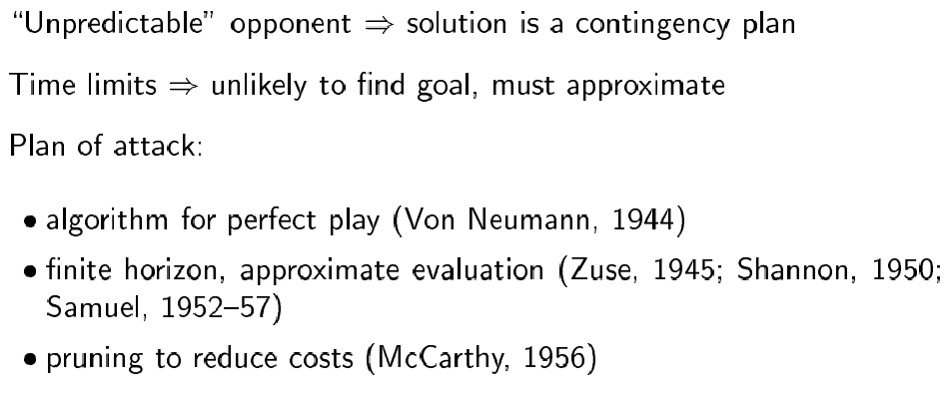
Game vs. search problem

Slide 10
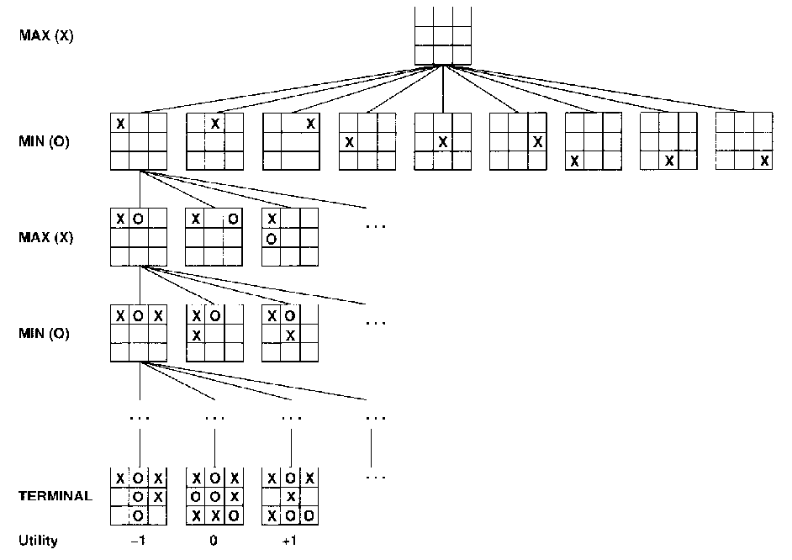
Example: Tic-Tac-Toe

Slide 11
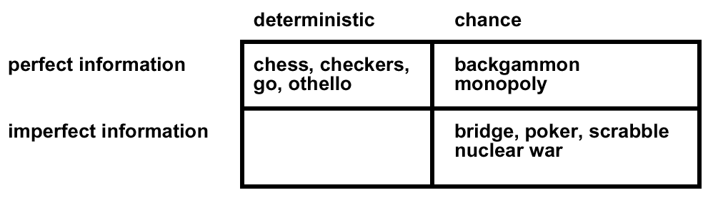
Type of games

Slide 12
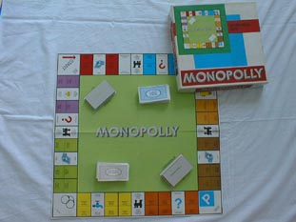
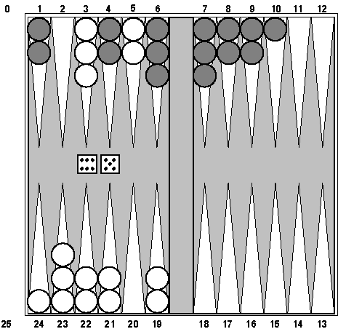
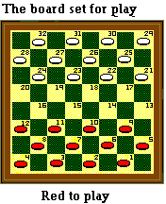
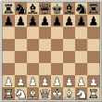
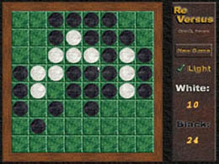

Type of games

Slide 13
The minimax algorithm
Perfect play for deterministic environments with perfect information
Basic idea: choose move with highest minimax value = best achievable payoff against best play
Algorithm:
Generate game tree completely
Determine utility of each terminal state
Propagate the utility values upward in the three by applying MIN and MAX operators on the nodes in the current level
At the root node use minimax decision to select the move with the max (of the min) utility value
Steps 2 and 3 in the algorithm assume that the opponent will play perfectly.

Slide 14
Generate Game Tree

Slide 15
Generate Game Tree
x
 | x
x
 |  | x

Slide 16
Generate Game Tree
 | x
 | x | o
o | x
 | x
 | o
 | x
o

Slide 17
Generate Game Tree
 | x
1 ply
1 move
 | x | o
o | x
 | x
 | o
 | x
o

Slide 18
A subtree
x
o
x
o
x
o
win
lose
x
o
x
x
o
x
x
o
x
draw
x
o
x
o
x
o
x
o
x
o
x
o
x
o
x
x
o
x
x
o
x
x
o
x
x
o
x
x
o
x
x
o
x
x
o
x
o
o
x
o
x
o
o
x
o
x
o
o
o
o
x
o
x
o
o
x
o
o
x
o
x
o
x
x
o
x
x
o
x
x
o
x
x
o
x
o
o
x
o
o
x
x
o
x
o
x
o
x
x
o
x
x
o
o
x
o

Slide 19
What is a good move?
x
o
x
o
x
o
win
lose
x
o
x
x
o
x
x
o
x
draw
x
o
x
o
x
o
x
o
x
o
x
o
x
o
x
x
o
x
x
o
x
x
o
x
x
o
x
x
o
x
x
o
x
x
o
x
o
o
x
o
x
o
o
x
o
x
o
o
o
o
x
o
x
o
o
x
o
o
x
o
x
o
x
x
o
x
x
o
x
x
o
x
x
o
x
o
o
x
o
o
x
x
o
x
o
x
o
x
x
o
x
x
o
o
x
o

Slide 20
Minimax
3
12
8
2
4
6
14
5
2
Minimize opponent’s chance
Maximize your chance

Slide 21
Minimax
3
2
2
MIN
3
12
8
2
4
6
14
5
2
Minimize opponent’s chance
Maximize your chance

Slide 22
Minimax
3
MAX
3
2
2
MIN
3
12
8
2
4
6
14
5
2
Minimize opponent’s chance
Maximize your chance

Slide 23
Minimax
3
MAX
3
2
2
MIN
3
12
8
2
4
6
14
5
2
Minimize opponent’s chance
Maximize your chance

Slide 24
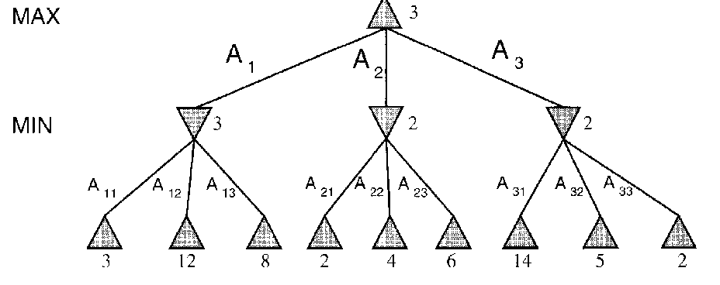
minimax = maximum of the minimum
1st ply
2nd ply

Slide 25
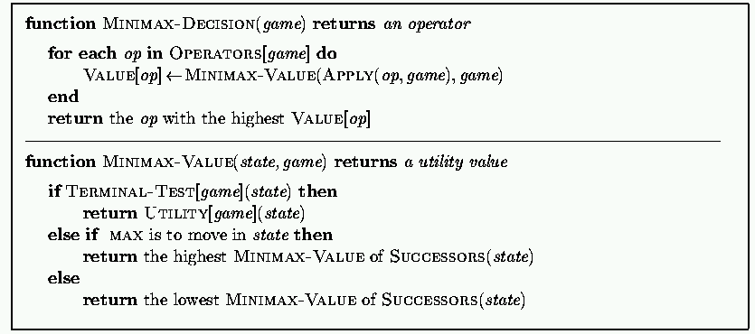
Minimax: Recursive implementation
Complete: ? Optimal: ?
Time complexity: ? Space complexity: ?

Slide 26
Minimax: Recursive implementation
Complete: Yes, for finite state-space Optimal: Yes
Time complexity: O(b^{m}) Space complexity: O(bm) (= DFS Does not keep all nodes in memory.)

Slide 27
Do We Have To Do All That Work?
MAX
MIN
3
12
8

Slide 28
Do We Have To Do All That Work?
3
MAX
3
MIN
3
12
8

Slide 29
Do We Have To Do All That Work?
3
MAX
3
2
MIN
3
12
8
2
Since 2 is smaller than 3, then there is no need for
further search

Slide 30
Do We Have To Do All That Work?
3
MAX
3
X
2
MIN
3
12
8
14
5
2
More on this next time: α-β pruning

Slide 31
1. Move evaluation without complete search
Complete search is too complex and impractical
Evaluation function: evaluates value of state using heuristics and cuts off search
New MINIMAX:
CUTOFF-TEST: cutoff test to replace the termination condition (e.g., deadline, depth-limit, etc.)
EVAL: evaluation function to replace utility function (e.g., number of chess pieces taken)

Slide 32
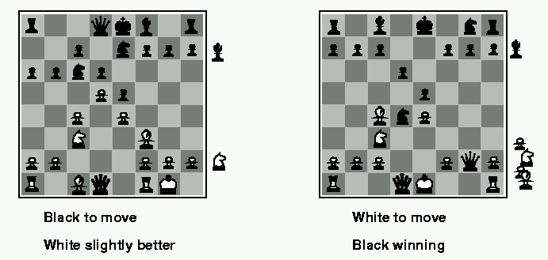
Evaluation functions
Weighted linear evaluation function: to combine n heuristics f = w₁f₁ ₊ w₂f_{2 + … +} w_{n}f_{n}
E.g, w’s could be the values of pieces (1 for prawn, 3 for bishop etc.) f’s could be the number of type of pieces on the board

Slide 33
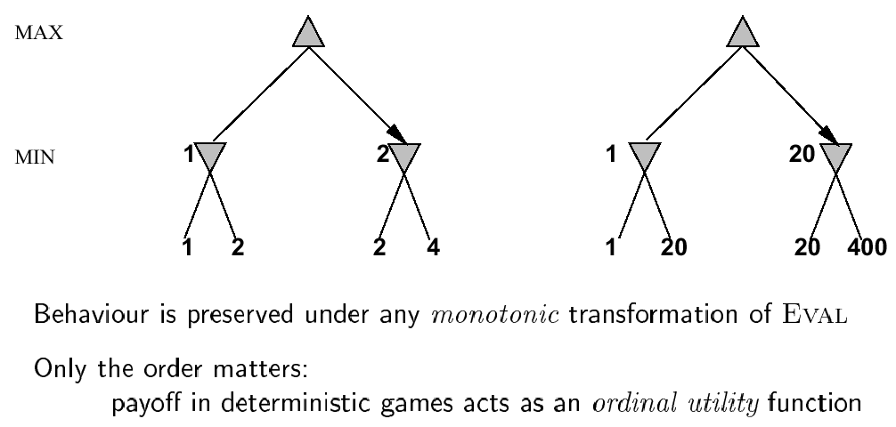
Note: exact values do not matter

Slide 34
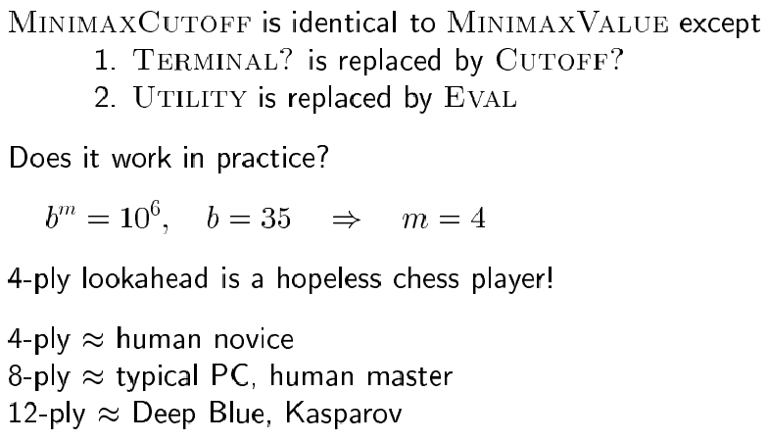
Minimax with cutoff: viable algorithm?
Assume we have 100 seconds, evaluate 10⁴ nodes/s; can evaluate 10⁶ nodes/move

Slide 35
2. α-β pruning: search cutoff
Pruning: eliminating a branch of the search tree from consideration without exhaustive examination of each node
α-β pruning: the basic idea is to prune portions of the search tree that cannot improve the utility value of the max or min node, by just considering the values of nodes seen so far.
Does it work? Yes, in roughly cuts the branching factor from b to √b resulting in double as far look-ahead than pure minimax

Slide 36
α-β pruning: example
≥ 6
MAX
MIN
6
6
12
8

Slide 37
α-β pruning: example
≥ 6
MAX
MIN
6
≤ 2
6
12
8
2

Slide 38
α-β pruning: example
≥ 6
MAX
MIN
6
≤ 2
≤ 5
6
12
8
2
5

Slide 39
α-β pruning: example
≥ 6
MAX
Selected move
MIN
6
≤ 2
≤ 5
6
12
8
2
5

Slide 40
α-β pruning: general principle
Player
m
α
Opponent
If α > v then MAX will chose m so prune tree under n
Similar for β for MIN
Player
Opponent
n
v

Slide 41
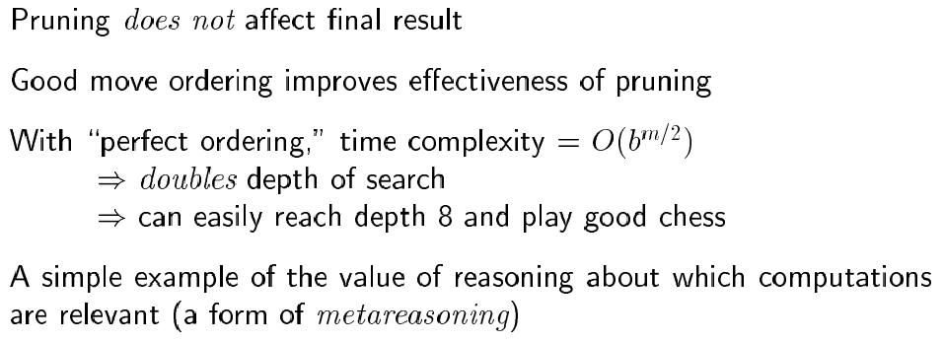
Properties of α-β

Slide 42
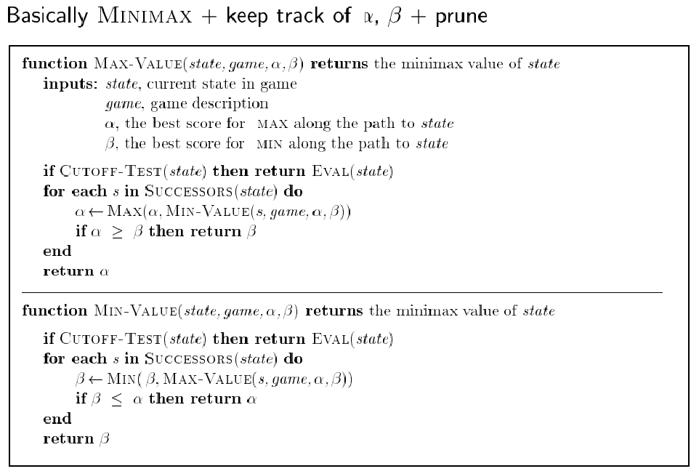
The α-β algorithm:

Slide 43
More on the α-β algorithm
Same basic idea as minimax, but prune (cut away) branches of the tree that we know will not contain the solution.

Slide 44
Remember: Minimax: Recursive implementation
Complete: Yes, for finite state-space Optimal: Yes
Time complexity: O(b^{m}) Space complexity: O(bm) (= DFS Does not keep all nodes in memory.)

Slide 45
More on the α-β algorithm
Same basic idea as minimax, but prune (cut away) branches of the tree that we know will not contain the solution.
Because minimax is depth-first, let’s consider nodes along a given path in the tree. Then, as we go along this path, we keep track of:
α : Best choice so far for MAX
β : Best choice so far for MIN

Slide 46
More on the α-β algorithm: start from Minimax
Note: These are both
Local variables. At the
Start of the algorithm,
We initialize them to
α = -∞ and β = +∞

Slide 47
α-β algorithm:

Slide 48
Alpha-Beta Algorithm
Update the alpha/beta value of the parent of a node N when the search below N has been completed or discontinued
Discontinue the search below a MAX node N if its alpha value is ≥ the beta value of a MIN ancestor of N
Discontinue the search below a MIN node N if its beta value is ≤ the alpha value of a MAX ancestor of N

Slide 49
Example
0
5
-3
3
3
-3
0
2
-2
3
5
2
5
-5
0
1
5
1
-3
0
-5
5
-3
3
2

Slide 50
Example
0
0
5
-3
3
3
-3
0
2
-2
3
5
2
5
-5
0
1
5
1
-3
0
-5
5
-3
3
2

Slide 51
Example
0
0
0
5
-3
3
3
-3
0
2
-2
3
5
2
5
-5
0
1
5
1
-3
0
-5
5
-3
3
2

Slide 52
Example
0
0
-3
0
5
-3
3
3
-3
0
2
-2
3
5
2
5
-5
0
1
5
1
-3
0
-5
5
-3
3
2

Slide 53
Example
0
0
-3
0
5
-3
3
3
-3
0
2
-2
3
5
2
5
-5
0
1
5
1
-3
0
-5
5
-3
3
2

Slide 54
Example
0
0
0
-3
0
5
-3
3
3
-3
0
2
-2
3
5
2
5
-5
0
1
5
1
-3
0
-5
5
-3
3
2

Slide 55
Example
0
0
3
0
-3
3
0
5
-3
3
3
-3
0
2
-2
3
5
2
5
-5
0
1
5
1
-3
0
-5
5
-3
3
2

Slide 56
Example
0
0
3
0
-3
3
0
5
-3
3
3
-3
0
2
-2
3
5
2
5
-5
0
1
5
1
-3
0
-5
5
-3
3
2

Slide 57
Example
0
0
0
0
3
0
-3
3
0
5
-3
3
3
-3
0
2
-2
3
5
2
5
-5
0
1
5
1
-3
0
-5
5
-3
3
2

Slide 58
Example
0
0
0
0
3
0
-3
3
5
0
5
-3
3
3
-3
0
2
-2
3
5
2
5
-5
0
1
5
1
-3
0
-5
5
-3
3
2

Slide 59
Example
0
0
0
0
3
2
0
-3
3
2
0
5
-3
3
3
-3
0
2
-2
3
5
2
5
-5
0
1
5
1
-3
0
-5
5
-3
3
2

Slide 60
Example
0
0
0
0
3
2
0
-3
3
2
0
5
-3
3
3
-3
0
2
-2
3
5
2
5
-5
0
1
5
1
-3
0
-5
5
-3
3
2

Slide 61
Example
0
0
2
0
2
0
3
2
0
-3
3
2
0
5
-3
3
3
-3
0
2
-2
3
5
2
5
-5
0
1
5
1
-3
0
-5
5
-3
3
2

Slide 62
Example
0
0
2
0
2
0
3
2
0
-3
3
2
0
5
-3
3
3
-3
0
2
-2
3
5
2
5
-5
0
1
5
1
-3
0
-5
5
-3
3
2

Slide 63
Example
0
0
0
2
0
2
0
3
2
0
-3
3
2
0
5
-3
3
3
-3
0
2
-2
3
5
2
5
-5
0
1
5
1
-3
0
-5
5
-3
3
2

Slide 64
Example
0
0
0
2
0
2
0
3
2
0
-3
3
2
5
0
5
-3
3
3
-3
0
2
-2
3
5
2
5
-5
0
1
5
1
-3
0
-5
5
-3
3
2

Slide 65
Example
0
0
0
2
0
2
0
3
2
1
0
-3
3
2
1
0
5
-3
3
3
-3
0
2
-2
3
5
2
5
-5
0
1
5
1
-3
0
-5
5
-3
3
2

Slide 66
Example
0
0
0
2
0
2
0
3
2
1
0
-3
3
2
1
-3
0
5
-3
3
3
-3
0
2
-2
3
5
2
5
-5
0
1
5
1
-3
0
-5
5
-3
3
2

Slide 67
Example
0
0
0
2
0
2
0
3
2
1
0
-3
3
2
1
-3
0
5
-3
3
3
-3
0
2
-2
3
5
2
5
-5
0
1
5
1
-3
0
-5
5
-3
3
2

Slide 68
Example
0
0
0
2
1
0
2
1
0
3
2
1
0
-3
3
2
1
-3
0
5
-3
3
3
-3
0
2
-2
3
5
2
5
-5
0
1
5
1
-3
0
-5
5
-3
3
2

Slide 69
Example
0
0
0
2
1
0
2
1
0
3
2
1
0
-3
3
2
1
-3
-5
0
5
-3
3
3
-3
0
2
-2
3
5
2
5
-5
0
1
5
1
-3
0
-5
5
-3
3
2

Slide 70
Example
0
0
0
2
1
0
2
1
0
3
2
1
0
-3
3
2
1
-3
-5
0
5
-3
3
3
-3
0
2
-2
3
5
2
5
-5
0
1
5
1
-3
0
-5
5
-3
3
2

Slide 71
Example
0
0
0
2
1
0
2
1
-5
0
3
2
1
-5
0
-3
3
2
1
-3
-5
0
5
-3
3
3
-3
0
2
-2
3
5
2
5
-5
0
1
5
1
-3
0
-5
5
-3
3
2

Slide 72
Example
0
0
0
2
1
0
2
1
-5
0
3
2
1
-5
0
-3
3
2
1
-3
-5
0
5
-3
3
3
-3
0
2
-2
3
5
2
5
-5
0
1
5
1
-3
0
-5
5
-3
3
2

Slide 73
Example
0
0
1
0
2
1
0
2
1
-5
0
3
2
1
-5
0
-3
3
2
1
-3
-5
0
5
-3
3
3
-3
0
2
-2
3
5
2
5
-5
0
1
5
1
-3
0
-5
5
-3
3
2

Slide 74
Example
1
0
1
0
2
1
2
0
2
1
-5
2
0
3
2
1
-5
2
0
-3
3
2
1
-3
-5
2
0
5
-3
3
3
-3
0
2
-2
3
5
2
5
-5
0
1
5
1
-3
0
-5
5
-3
3
2

Slide 75
Example
1
0
1
0
2
1
2
0
2
1
-5
2
0
3
2
1
-5
2
0
-3
3
2
1
-3
-5
2
0
5
-3
3
3
-3
0
2
-2
3
5
2
5
-5
0
1
5
1
-3
0
-5
5
-3
3
2

Slide 76
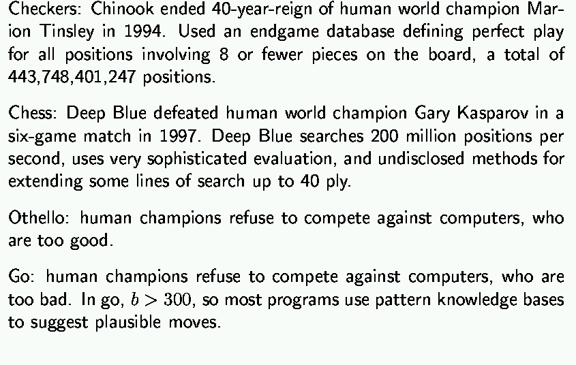
State-of-the-art for deterministic games

Slide 77
Remember: Minimax algorithm

Slide 78
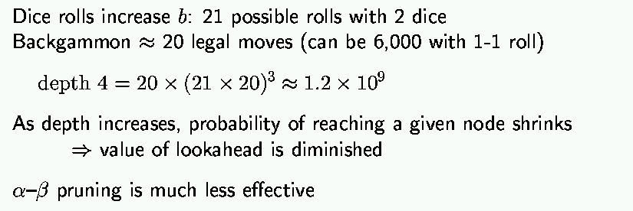
State-of-the-art for nondeterministic games

Slide 79


Questions

