Slide 1
C++ Programming: From Problem Analysis to Program Design, Third Edition
Chapter 6: Functions I

Slide 2
Objectives
In this chapter you will:
Learn about standard (predefined) functions and discover how to use them in a program
Learn about user-defined functions
Examine value-returning functions, including actual and formal parameters
Explore how to construct and use a value-returning, user-defined function in a program

Slide 3
Functions
Functions are like building blocks
They allow complicated programs to be divided into manageable pieces
Some advantages of functions:
A programmer can focus on just that part of the program and construct it, debug it, and perfect it
Different people can work on different functions simultaneously
Can be used in more than one place in a program or in different programs

Slide 4
Predefined Functions
In algebra, a function is defined as a rule or correspondence between values, called the function’s arguments, and the unique value of the function associated with the arguments
If f(x) = 2x + 5, then f(1) = 7, f(2) = 9, and f(3) = 11
1, 2, and 3 are arguments
7, 9, and 11 are the corresponding values

Slide 5
Predefined Functions (continued)
Some of the predefined mathematical functions are:
sqrt(x)
pow(x,y)
floor(x)
Predefined functions are organized into separate libraries
I/O functions are in iostream header
Math functions are in cmath header

Slide 6
The Power Function (pow)
pow(x,y) calculates x^{y}, pow(2,3) = 8.0
pow returns a value of type double
x and y are called the parameters (or arguments) of the function pow
Function pow has two parameters

Slide 7
The sqrt and floor Functions
The square root function sqrt(x)
Calculates the non-negative square root of x, for x >= 0.0
sqrt(2.25) is 1.5
Type double
Has only one parameter

Slide 8
The sqrt and floor Functions (continued)
The floor function floor(x)
Calculates largest whole number not greater than x
floor(48.79) is 48.0
Type double
Has only one parameter

Slide 9
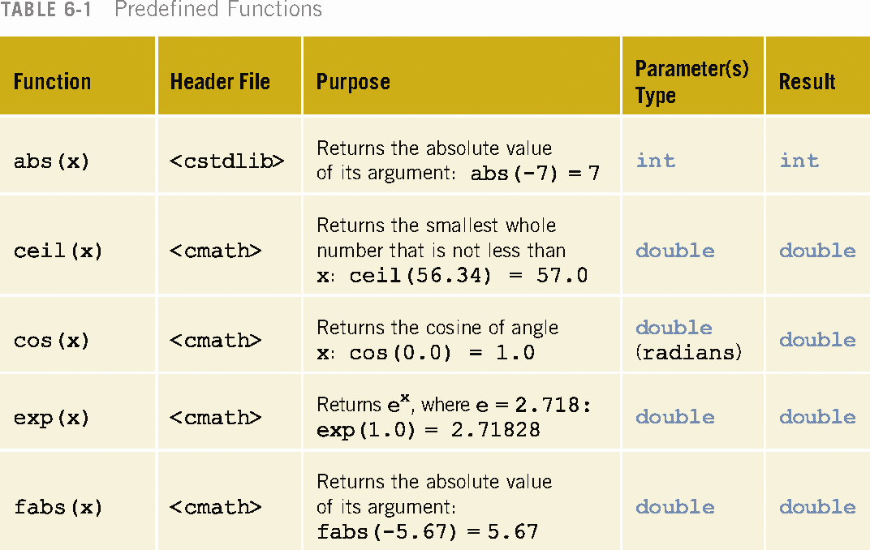

Slide 10
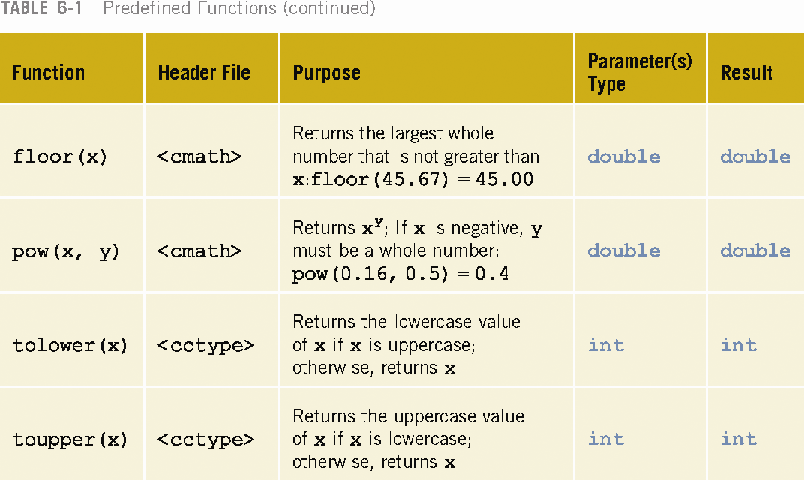

Slide 11
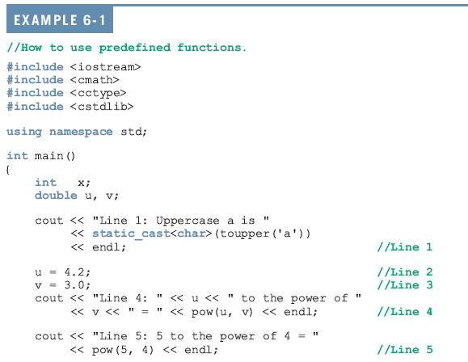

Slide 12
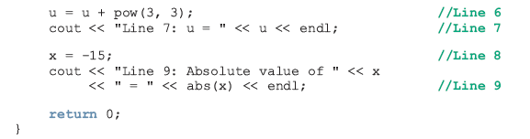
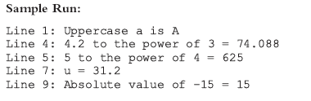

Slide 13
User-Defined Functions
Void functions: do not have a return type
Value-returning functions: have a data type
To use these functions you need to:
Include the correct header file
Know the name of the function
Know the number of parameters, if any
Know the data type of each parameter
Know the data type of the value computed by the function, called the type of the function

Slide 14
Value-Returning Functions
Because the value returned by a value-returning function is unique, we must:
Save the value for further calculation
Use the value in some calculation
Print the value
A value-returning function is used in an assignment or in an output statement

Slide 15
Value-Returning Functions (continued)
Properties that form the function definition:
Name of the function
Number of parameters
Data type of each parameter
Type of the function
Code required to accomplish the task (the body of the function)

Slide 16
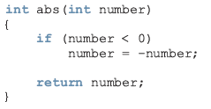
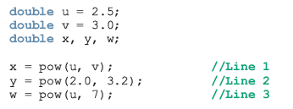

Slide 17
Value-Returning Functions (continued)
Heading: first four properties above
Formal Parameter: variable declared in the heading
Actual Parameter: variable or expression listed in a call to a function

Slide 18

Value-Returning Functions (continued)
Syntax:
functionType: type of the value returned by the function
Also called the data type

Slide 19

Syntax
The syntax of the formal parameter list is:
The syntax for a function call is:
The syntax for the actual parameter list is:

Slide 20
Functions
The formal parameter list can be empty
If the formal parameter list is empty
Parentheses are still needed
Function heading of the value-returning function takes either of the following forms:
functionType functionName()
In a function call the actual parameter is empty
A call to a value-returning function with an empty formal parameter list is:
functionName()

Slide 21
Value-Returning Functions
To call a value-returning function:
Use its name, with the actual parameters (if any) in parentheses
There is a one-to-one correspondence between actual and formal parameters

Slide 22
Value-Returning Functions (continued)
A value-returning function is called in an expression
Expression may be part of an assignment statement or an output statement
A function call in a program results in the execution of the body of the called function

Slide 23

The return Statement
Once the function computes the value, the function returns the value via the return statement
The syntax of the return statement is:
When a return statement executes
Function immediately terminates
Control goes back to the caller
When a return statement executes in the function main, the program terminates

Slide 24
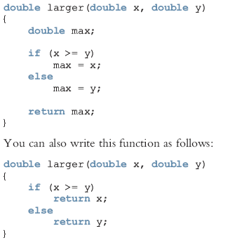

Slide 25
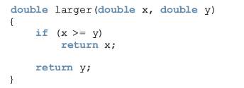
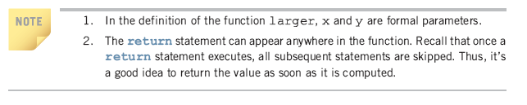

Slide 26

Function Prototype
Function Prototype: function heading without the body of the function
Syntax:
It is not necessary to specify the variable name in the parameter list
The data type of each parameter must be specified

Slide 27
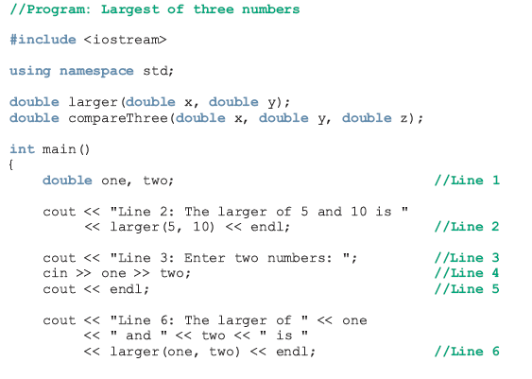

Slide 28
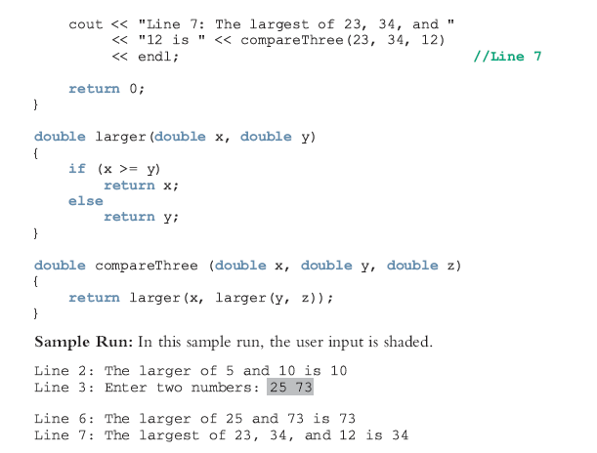

Slide 29
Flow of Execution
Execution always begins at
The first statement in the function main no matter where main is placed in the program
Other functions are executed only when they are called

Slide 30
Flow of Execution (Continued)
Function prototypes appear before any function definition
The compiler translates these first
The compiler can then correctly translate a function call

Slide 31
Flow of Execution (continued)
A function call statement results in
Transfer of control to the first statement in the body of the called function
After the last statement of the called function is executed
Control is passed back to the point immediately following the function call

Slide 32
Flow of Execution (continued)
A value-returning function returns a value
After executing the function
The value that the function returns replaces the function call statement

Slide 33
Programming Example
In this programming example, the function larger is used to determine the largest number from a set of numbers
Program determines the largest number from a set of 10 numbers
Input: A set of 10 numbers
Output: The largest of 10 numbers

Slide 34
Program Analysis
Suppose that the input data is:
15 20 7 8 28 21 43 12 35 3
Read the first number of the data set
Because this is the only number read to this point, you may assume that it is the largest number so far and call it max
Read the second number and call it num
Compare max and num, and store the larger number into max

Slide 35
Program Analysis (continued)
Now max contains the larger of the first two numbers
Read the third number and compare it with max and store the larger number into max
At this point, max contains the largest of the first three numbers
Read the next number, compare it with max, and store the larger into max
Repeat this process for each remaining number in the data set

Slide 36
Algorithm Design
Read the first number
Because this is the only number that you have read, it is the largest number so far
Save it in a variable called max
For each remaining number in the list
Read the next number
Store it in a variable called num
Compare num and max

Slide 37
Algorithm Design (continued)
If max < num
num is the new largest number
update the value of max by copying num into max
If max >= num, discard num; that is, do nothing
Because max now contains the largest number, print it

Slide 38
Example 1
#include <iostream>
using namespace std;
double larger(double x, double y);
double compare(double x, double y, double z, double f) {
double max = x;
if (y > max) max = y;
if (z > max) max = z;
if (f > max) max = f;
return max;
}
int main()
{
double a, b, c, d;
cout << "Enter 04 numbers:\n";
cin >> a >> b >> c >> d;
cout << "Numbers entered: " << a << ", " << b << ", " << c << ", " << d << endl;
cout << "The largest number is " << compare(a, b, c, d);
return 0;
}

Slide 39
Example 2
// Program: Return
#include<iostream>
using namespace std;
int square( int y ) // Heading y is Formal Parameter
{
return y * y; // The return Statement
}
int main()
{
for ( int x = 1; x <= 10; x++ )
cout << square( x ) << " "; //calling statement x is actual parameter
cout << endl;
return 0;
}

Slide 40
Example 3
// Program: Largest
#include <iostream>
using namespace std;
double larger(double x, double y)
{
if (x >= y)
return x;
else
return y;
}
int main()
{
double num; //variable to hold the current number
double max; //variable to hold the larger number
int count; //loop control variable
cout << "Enter 10 numbers." << endl;
cin >> num; //Step 1
max = num; //Step 1
for (count = 1; count < 10; count++) //Step 2
{
cin >> num; //Step 2a
max = larger(max, num); //Step 2b
}
cout << "The largest number is " << max<< endl; //Step 3
return 0;
}

